Slide 1
An NSS Audio-Visual
Library Presentation
Carlsbad Caverns Restoration Project
Sponsored by the Cave Research Foundation
and the National Speleological Society
(1987)
S202 77 Slides 1/21/2021

Slide 2
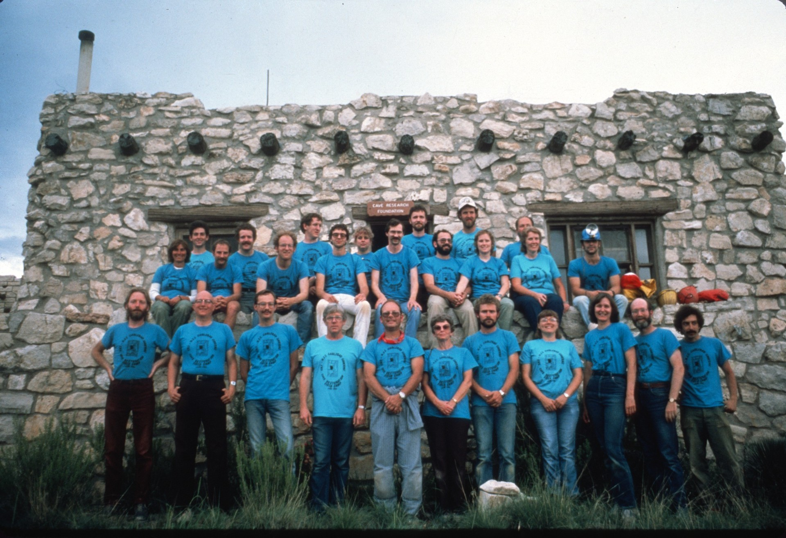
Notes:
The 28 cavers who participated stayed in two houses overlooking the entrance to Carlsbad Caverns.

Slide 3
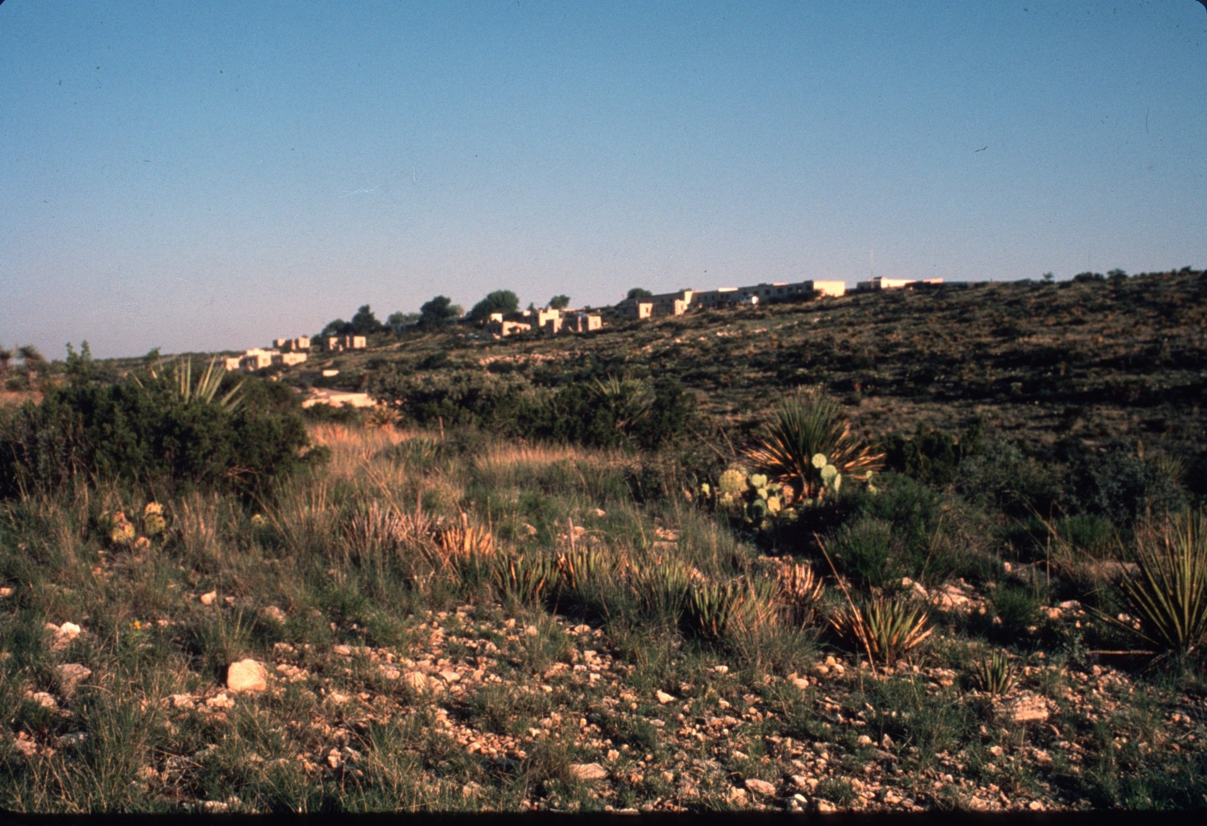
Notes:
Carlsbad Caverns entrance.

Slide 4
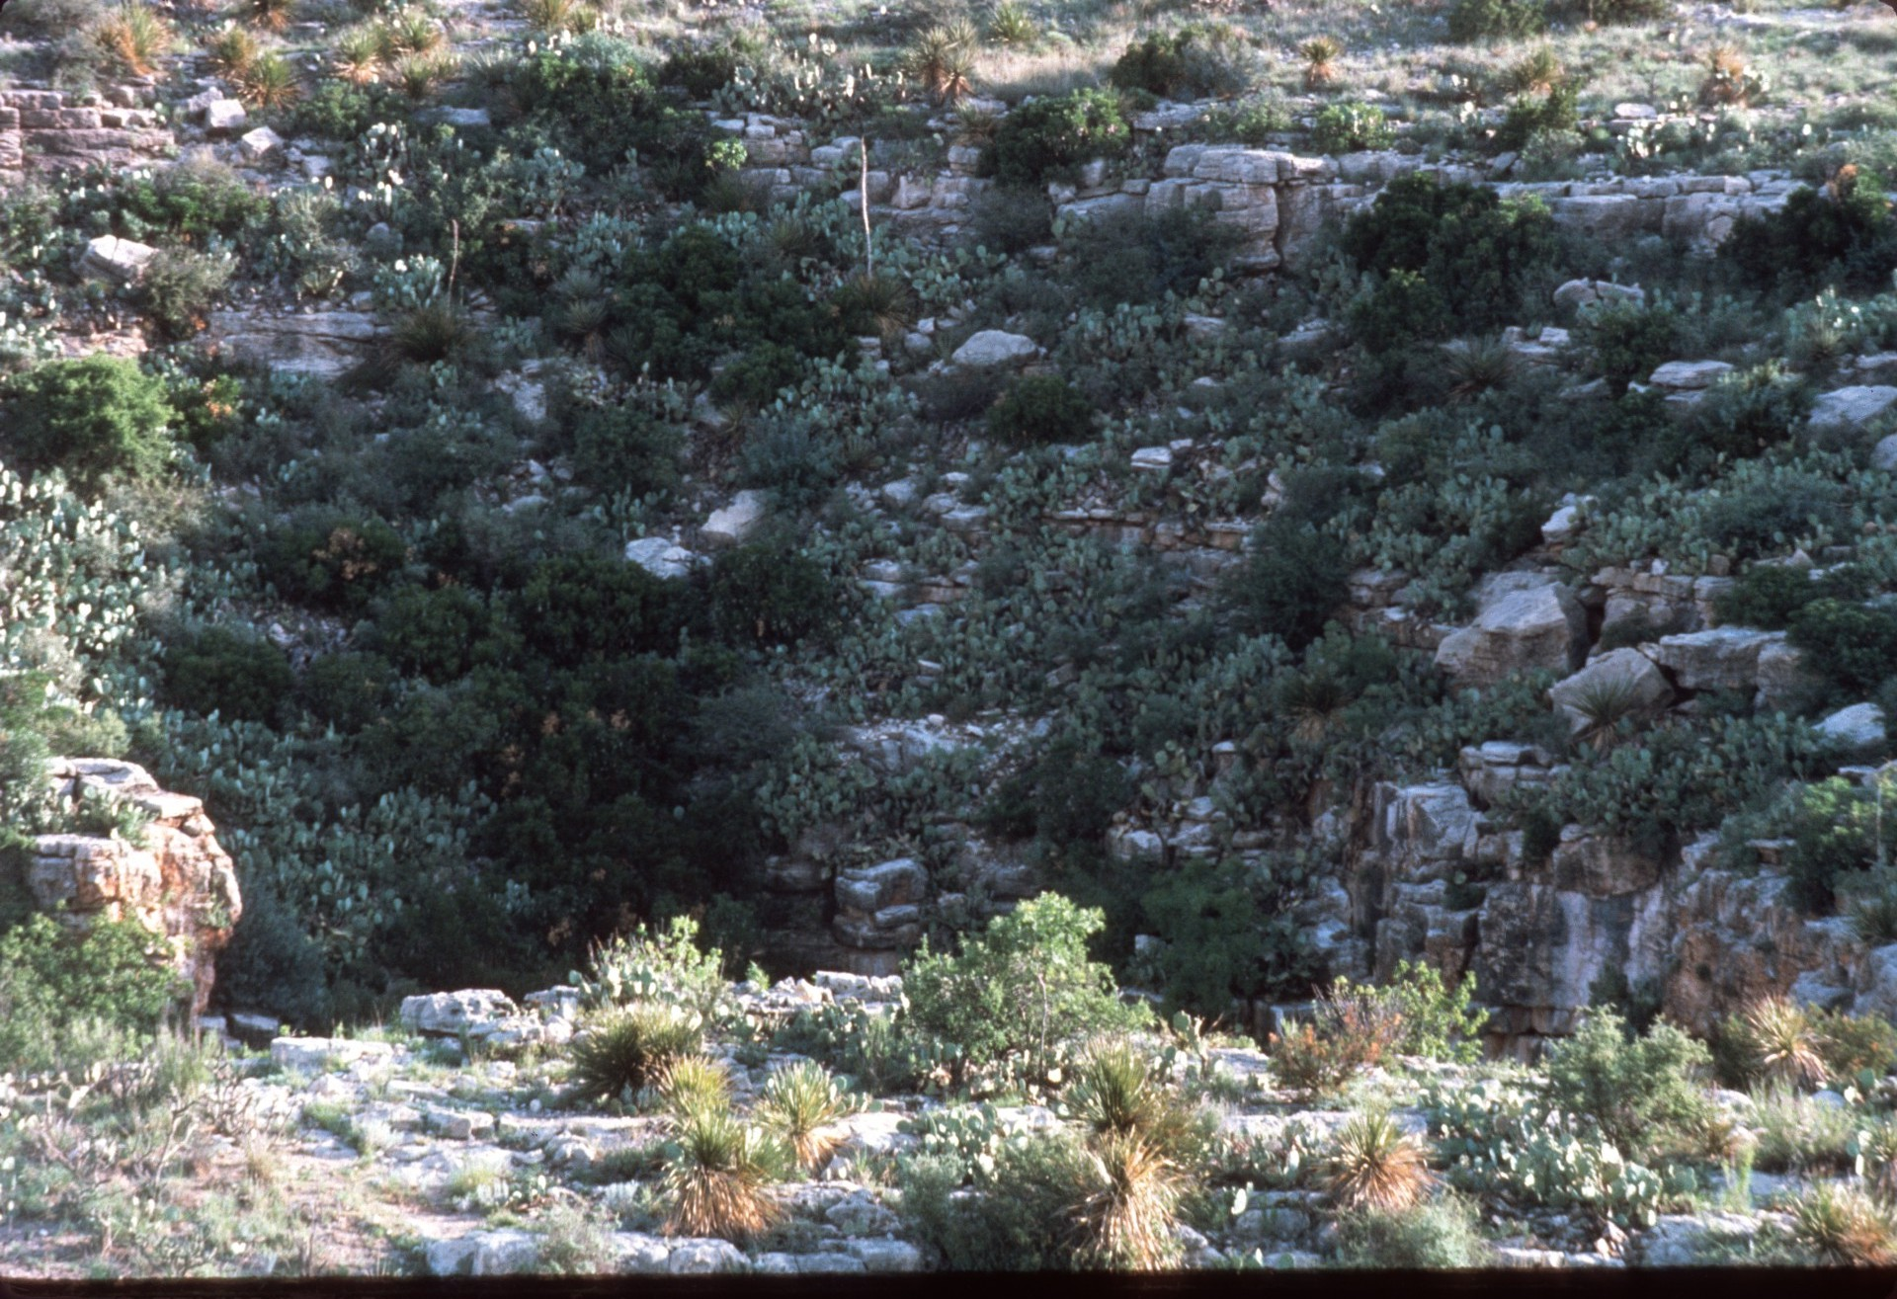
Notes:
Carlsbad Caverns entrance.

Slide 5
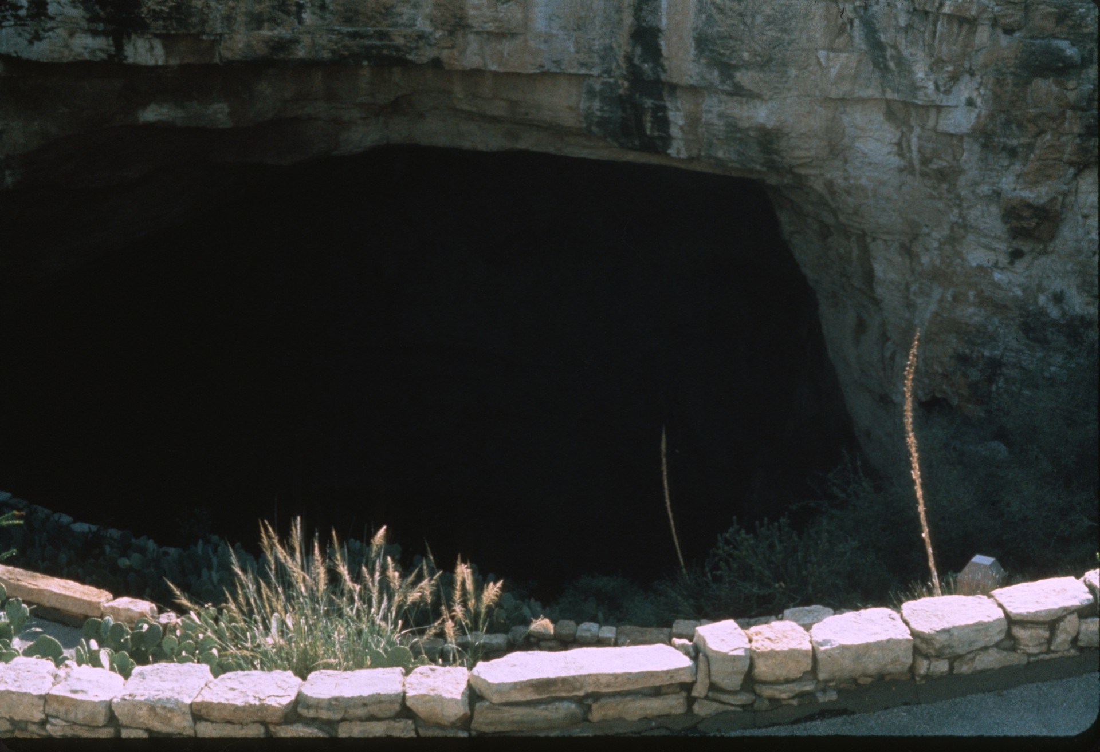

Slide 6
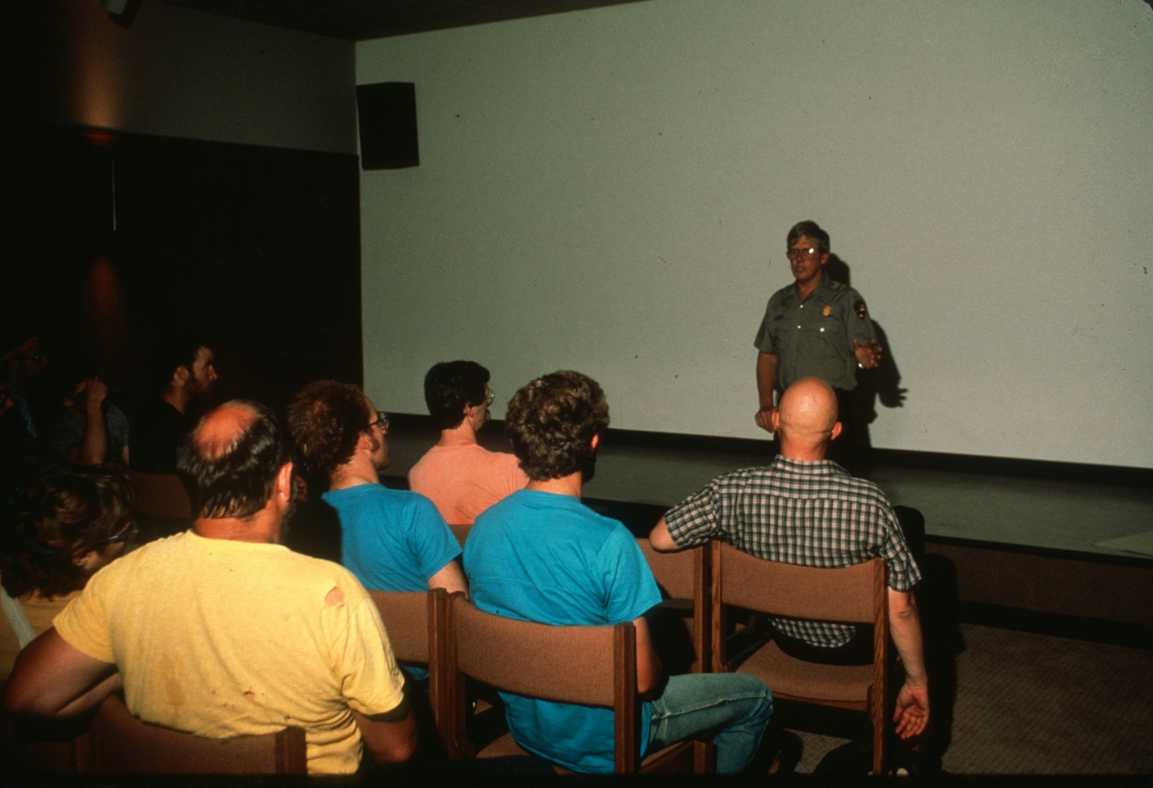
Notes:
On the morning of the first day of the five-day project Ron Kerbo, the only cave specialist in the National Park Service, briefed the participants.

Slide 7
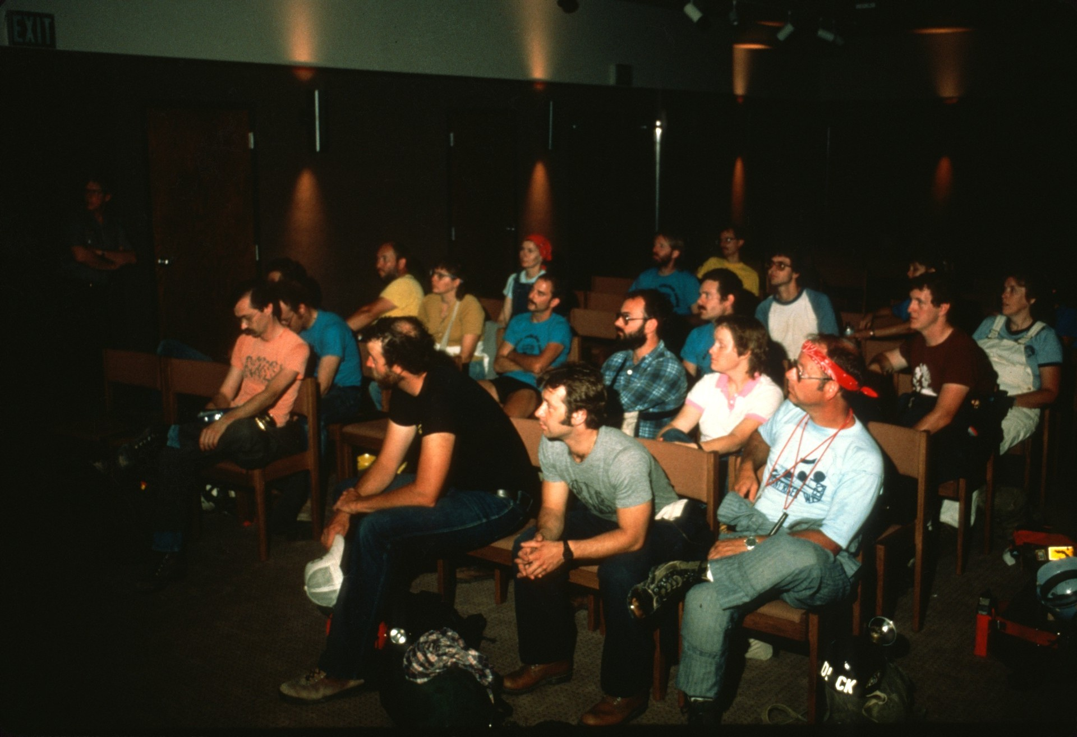
Notes:
Our goal was to clean specific areas of the Big Room floor of debris thrown to the side during trail construction more than 50 years ago.

Slide 8
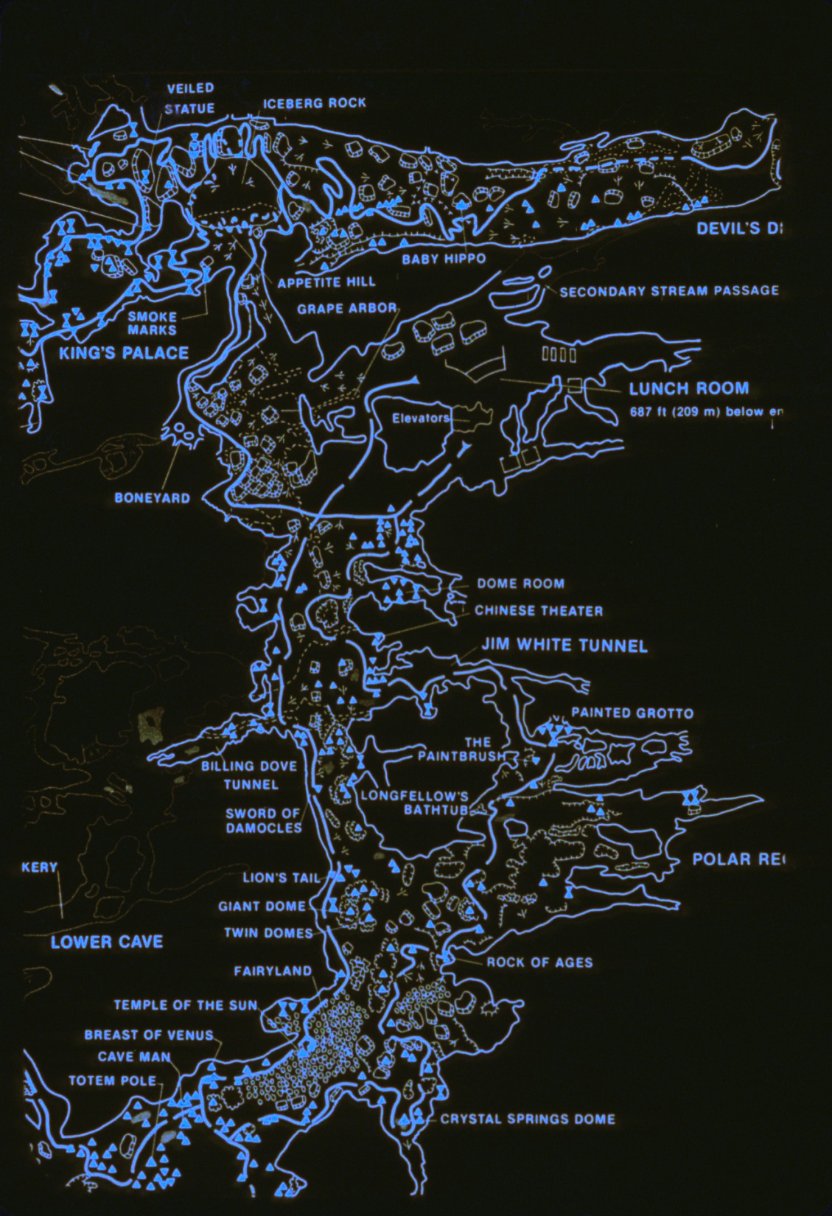
Notes:
Using the elevator to descend, we were quickly in the Big Room 687 feet below the entrance. We broke into groups and started to work.

Slide 9
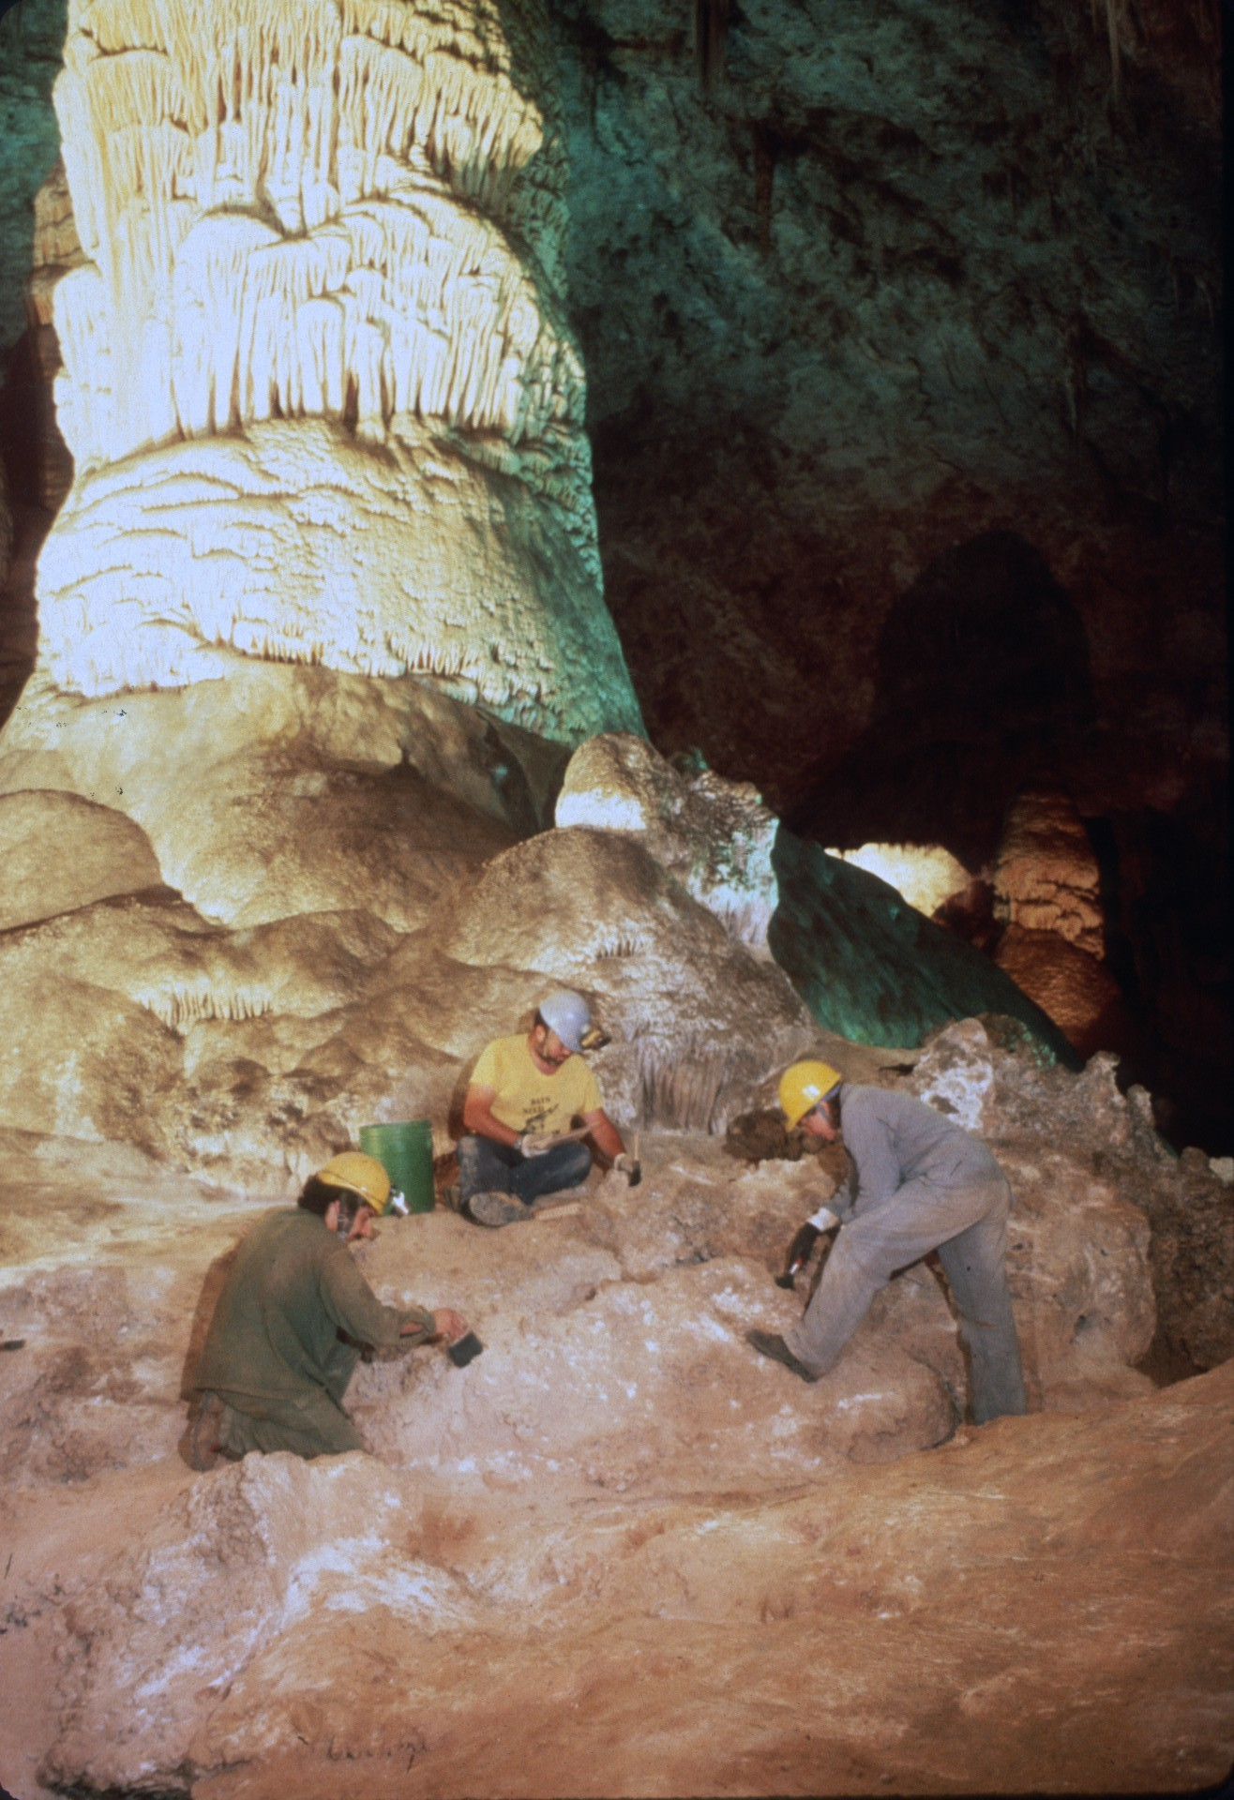
Notes:
Ron had four areas in the Big Room that needed attention: Giant Dome,

Slide 10
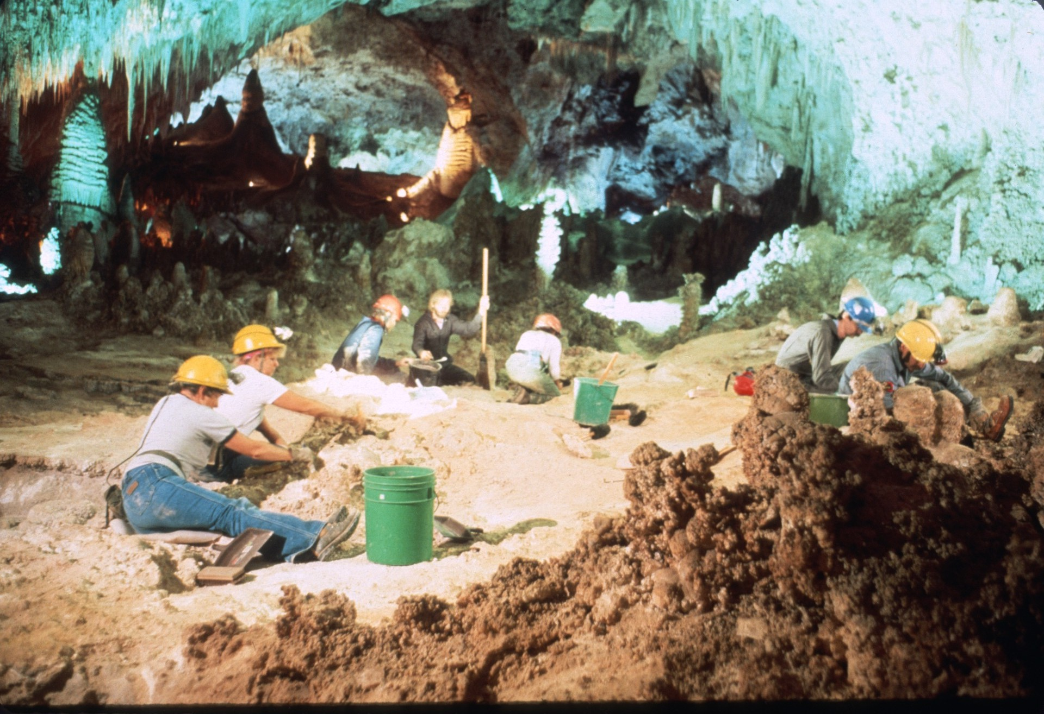
Notes:
two areas near the Totem Pole,

Slide 11
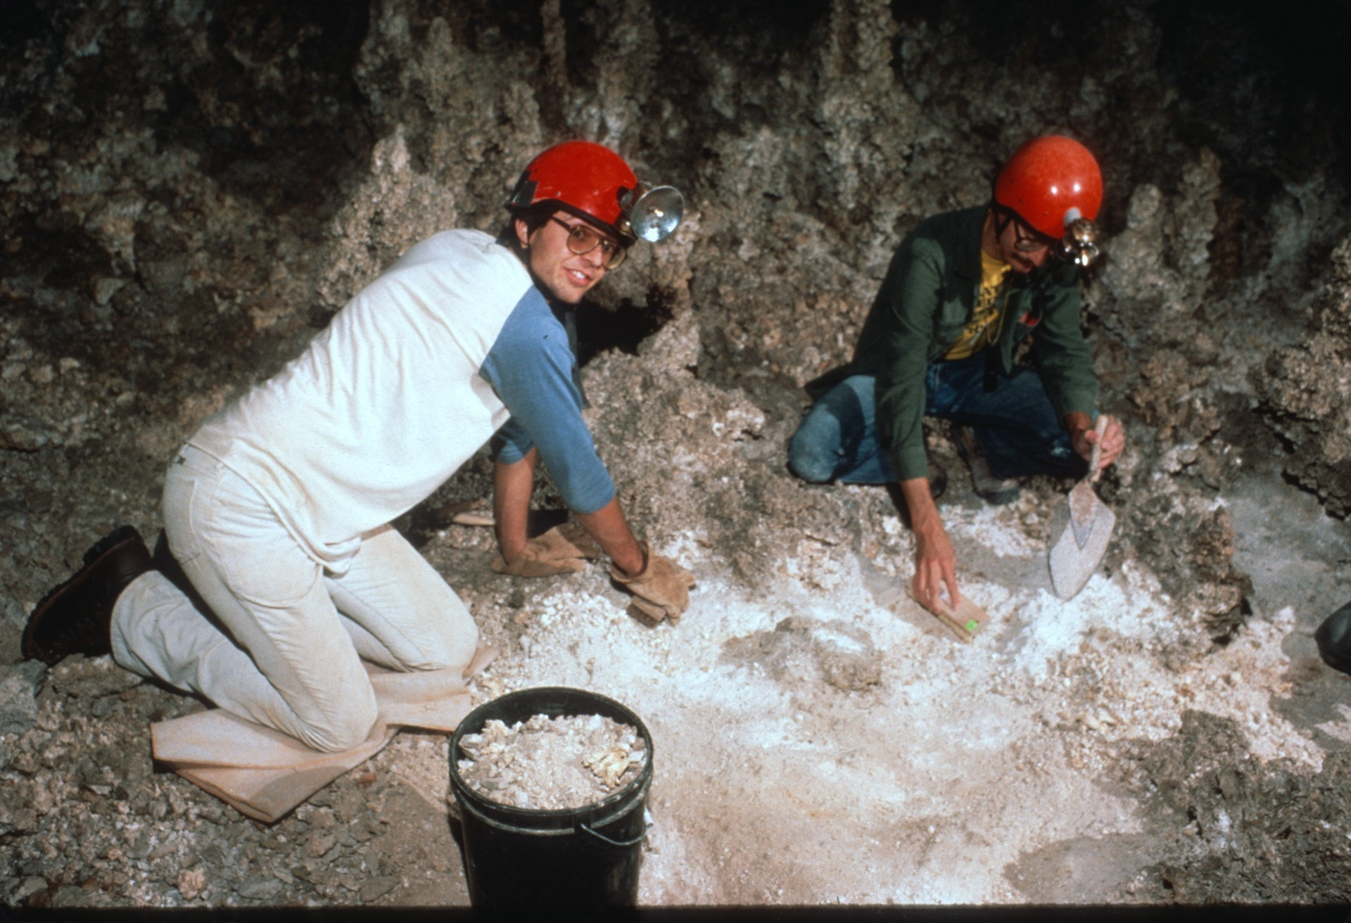
Notes:
and just south of the elevator near the Dome Room.

Slide 12
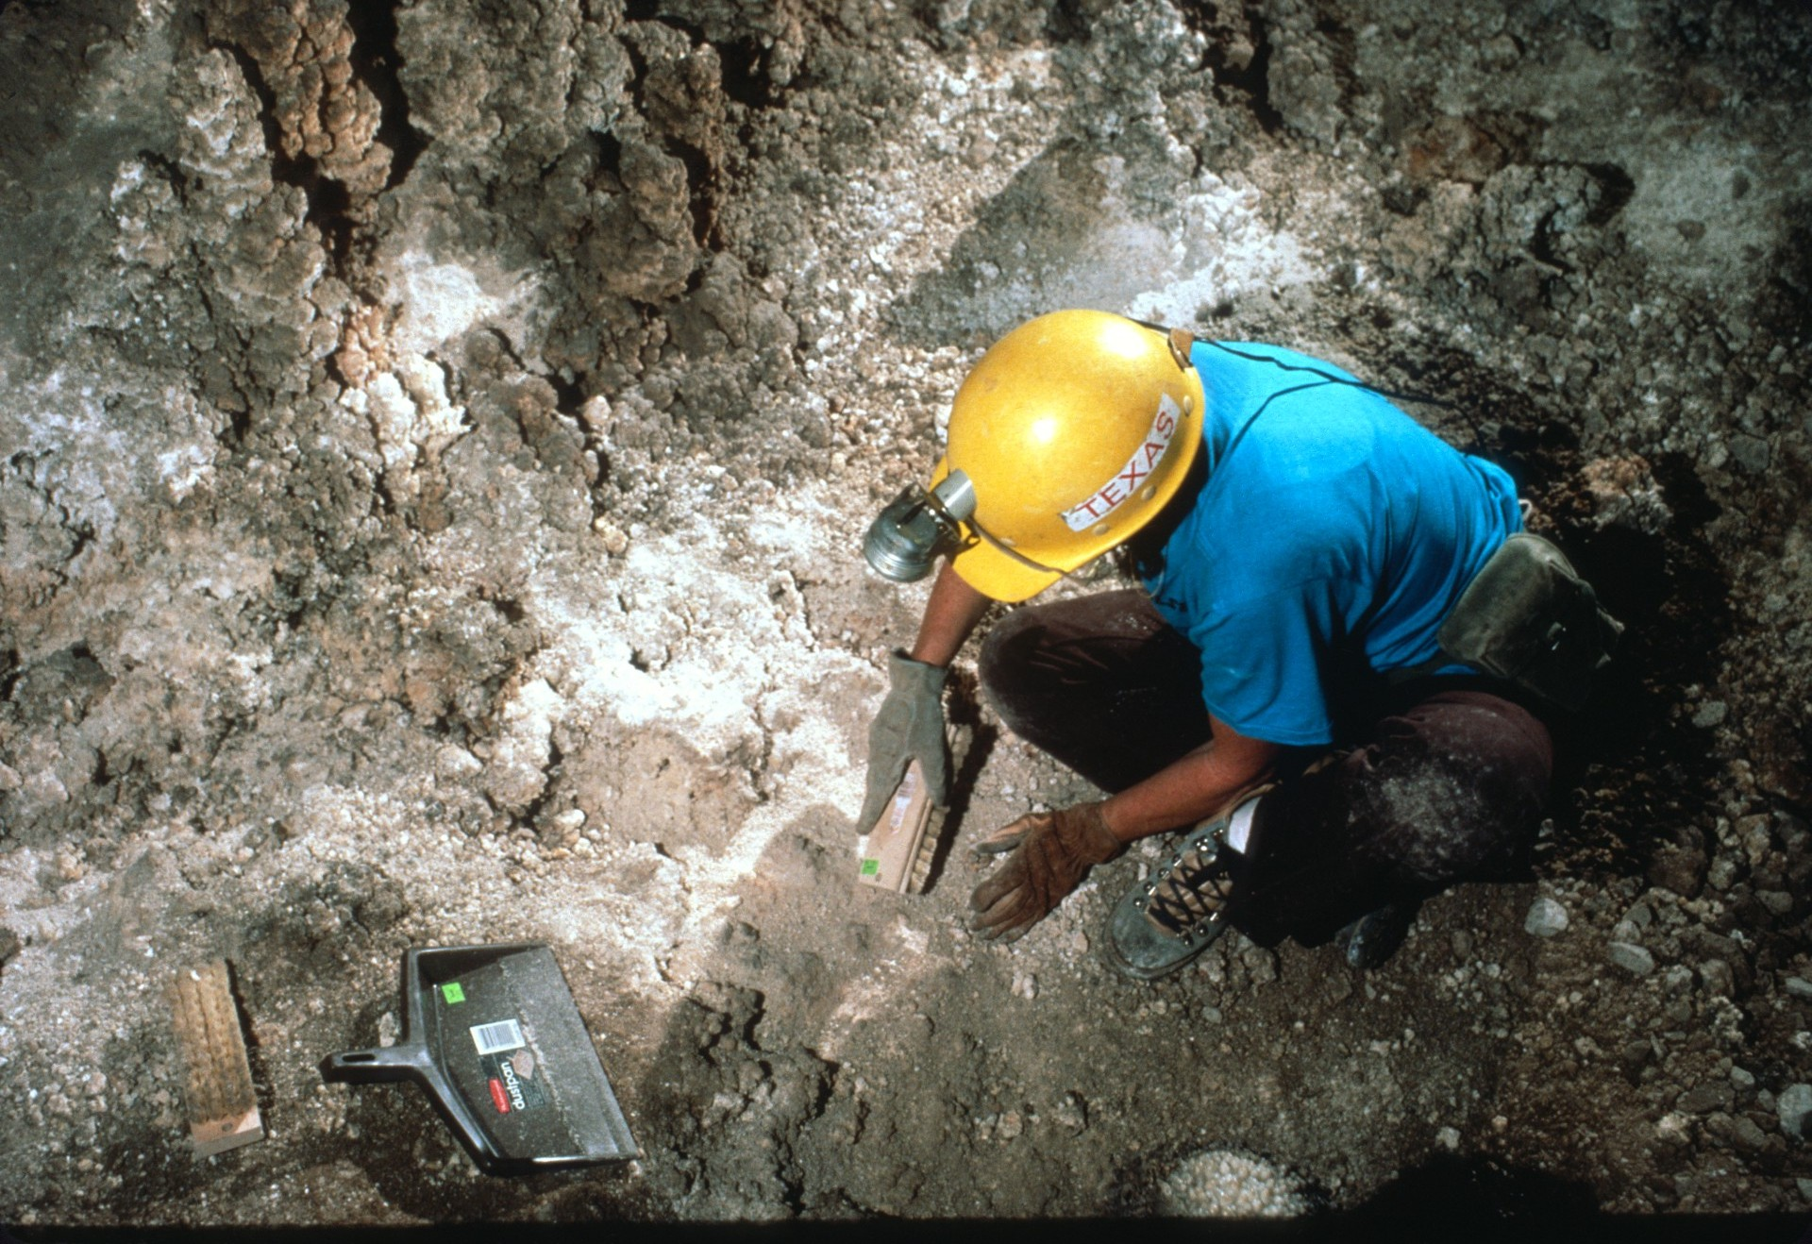
Notes:
Working the cave was quite pleasant and the hours and days passed quickly.

Slide 13
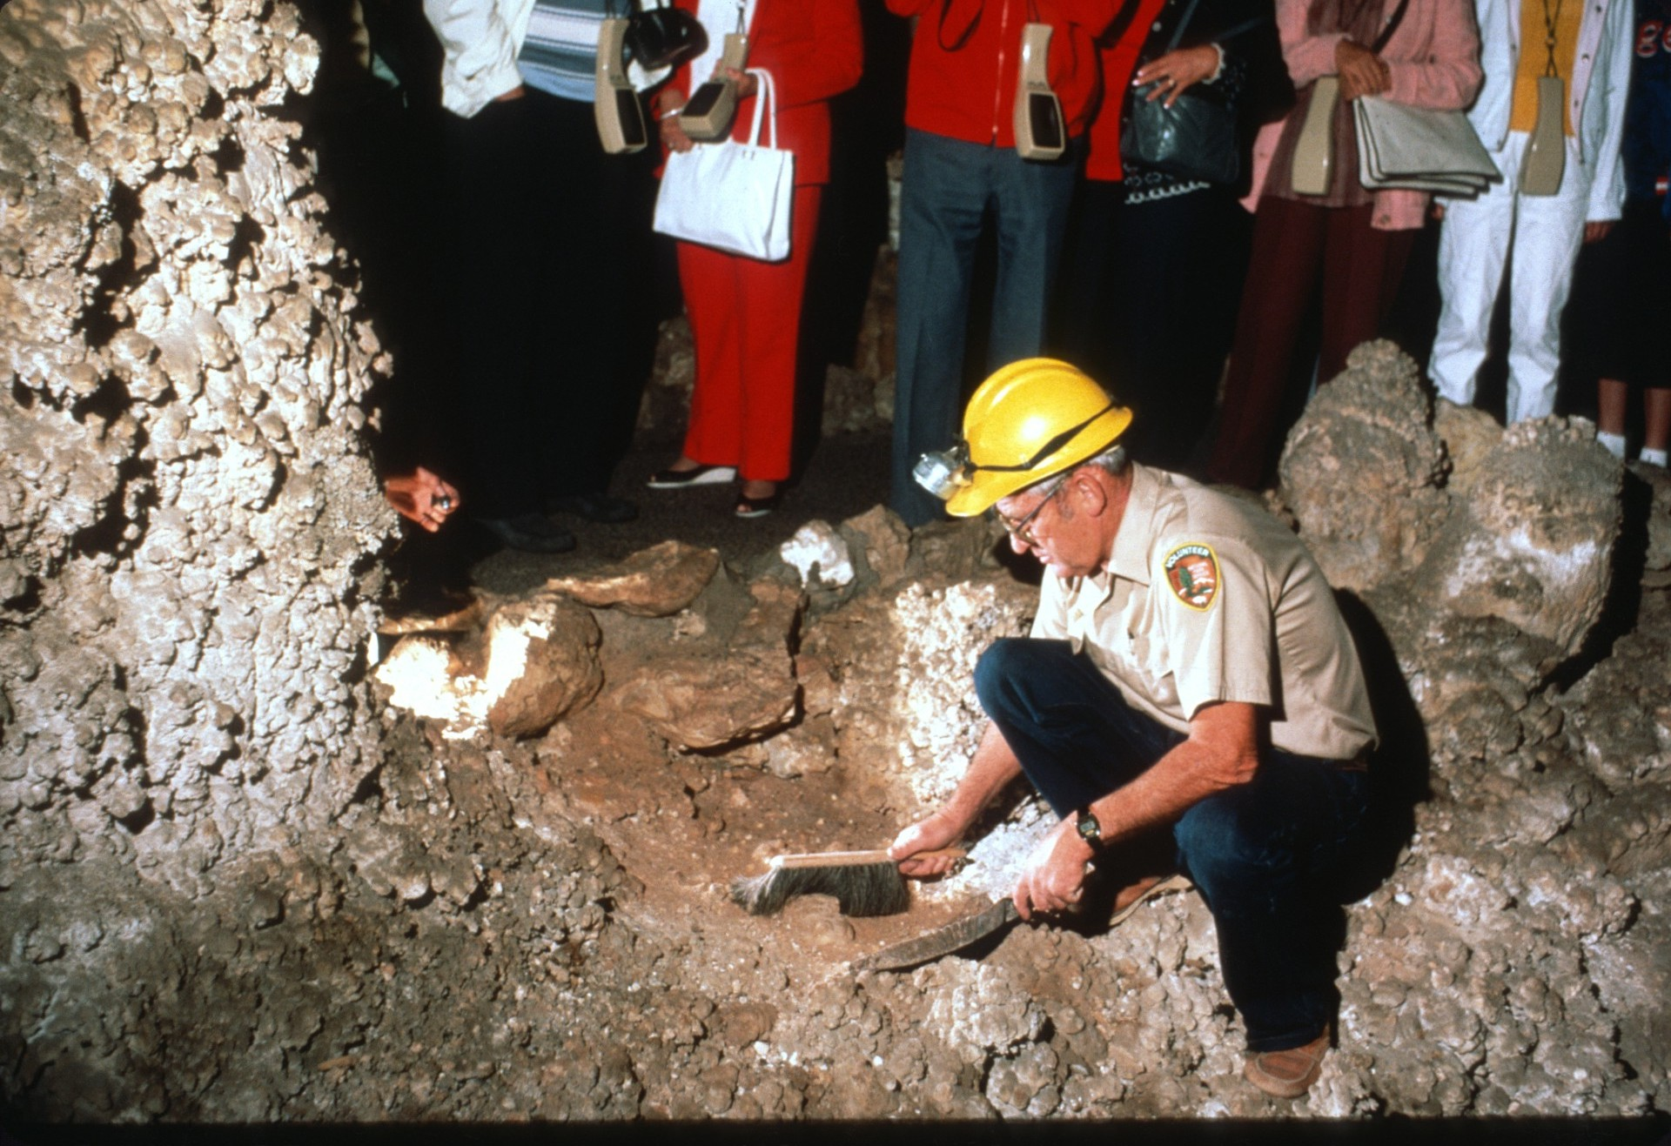
Notes:
All the while tourists looked over your shoulder and asked questions like “Are you digging for gold?””

Slide 14
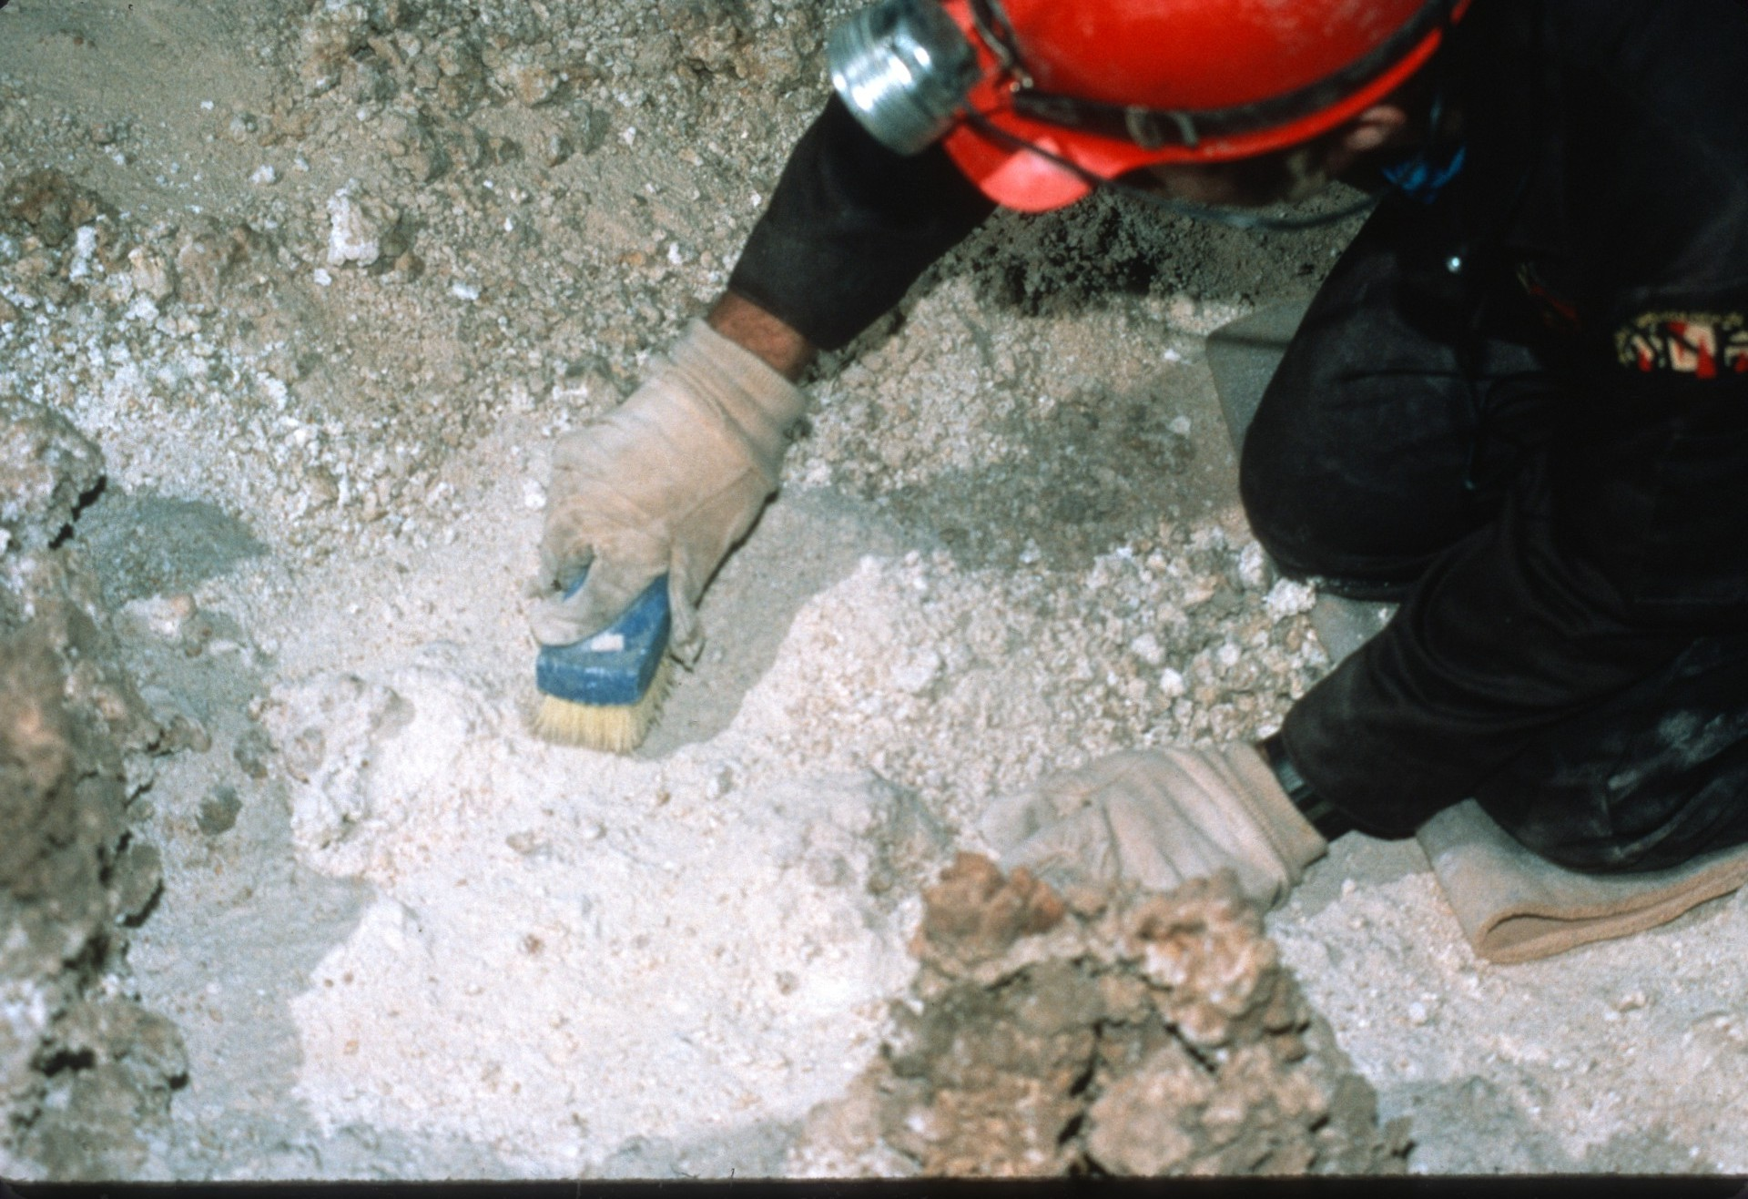
Notes:
Gradually rocks and pebbles that littered the floor were cleared away and the remaining dust was removed.

Slide 16
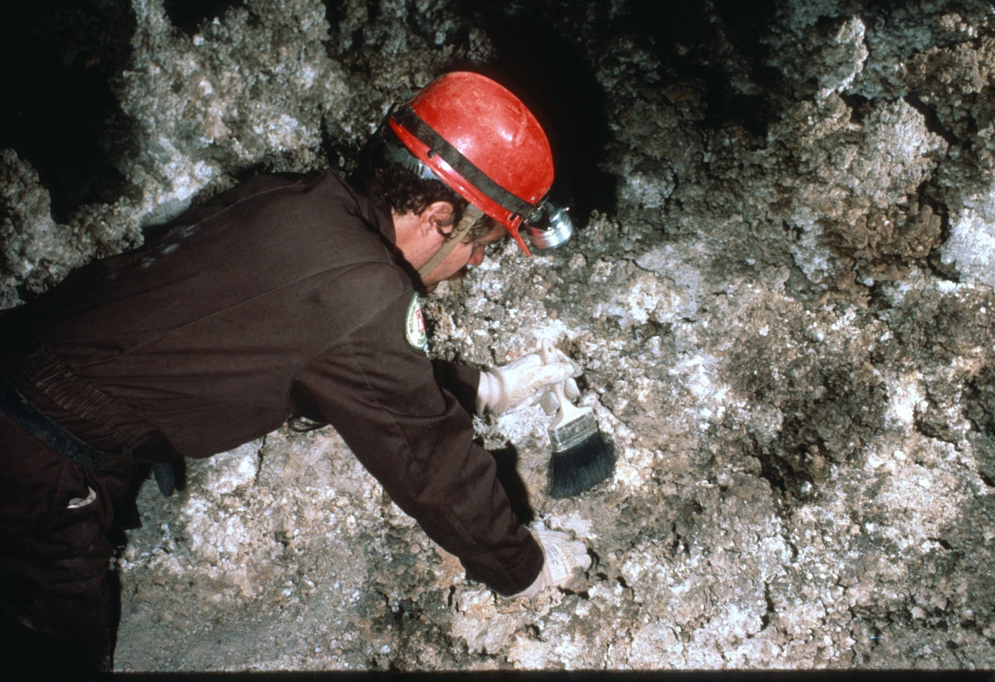

Slide 17
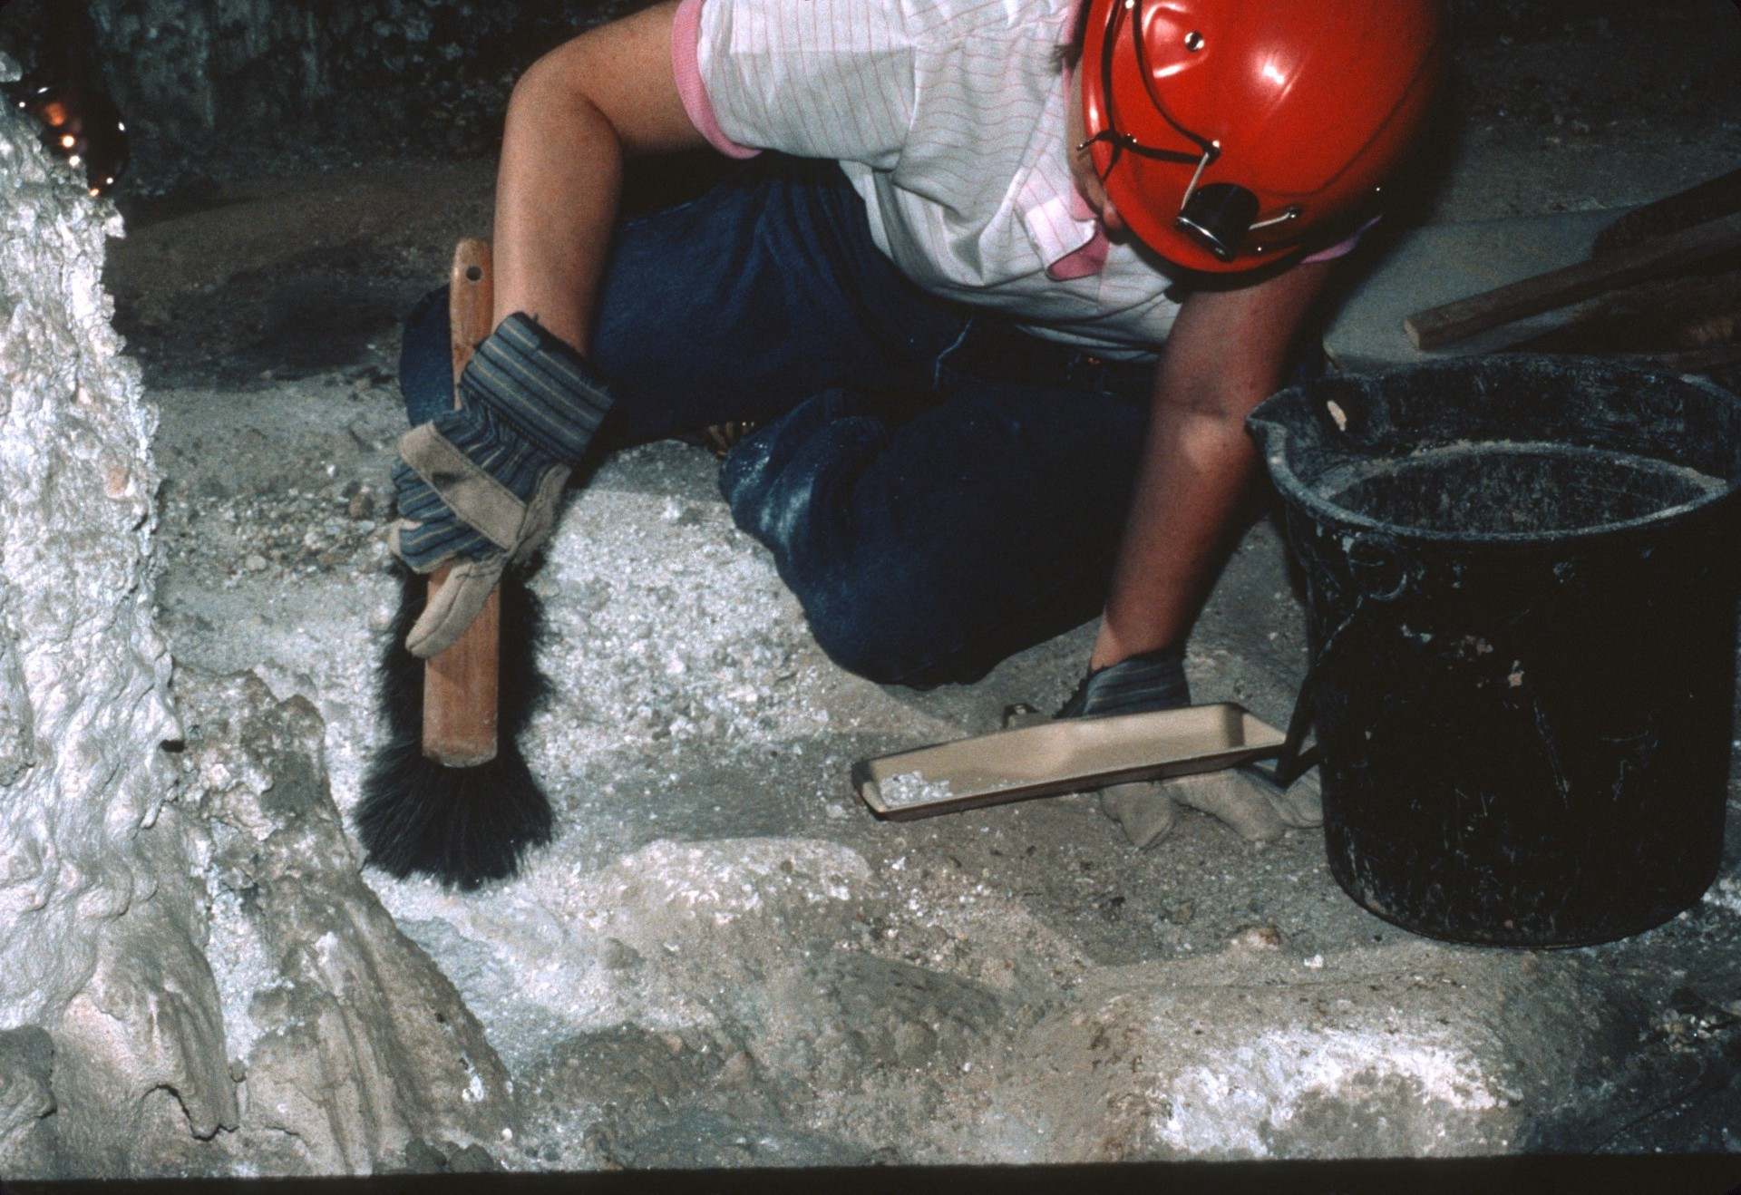

Slide 18
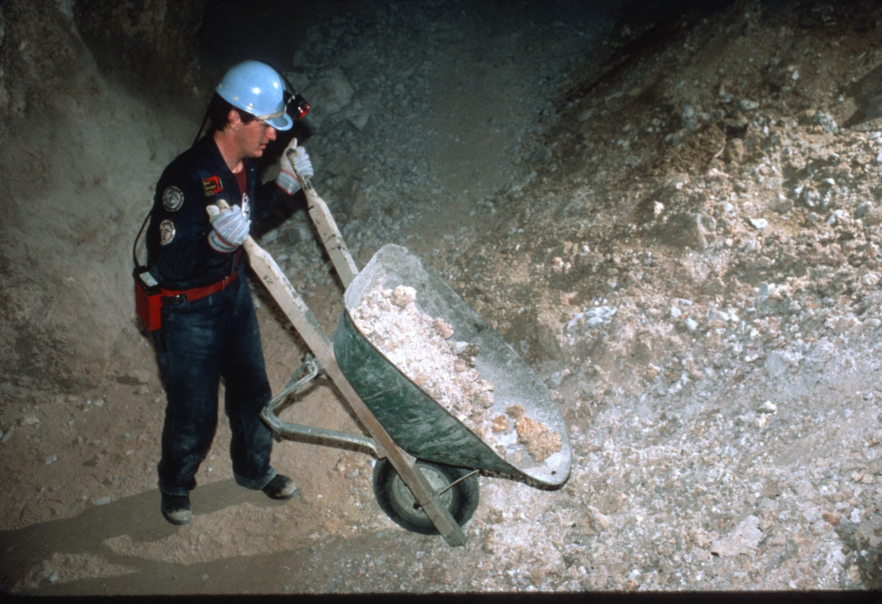
Notes:
The debris was loaded in wheelbarrows and hauled away.

Slide 19
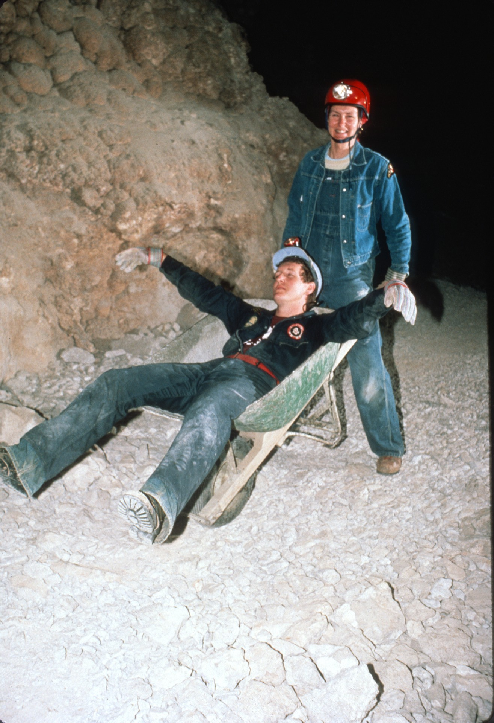
Notes:
By the end of the day we were tired, but it was worth it.

Slide 20
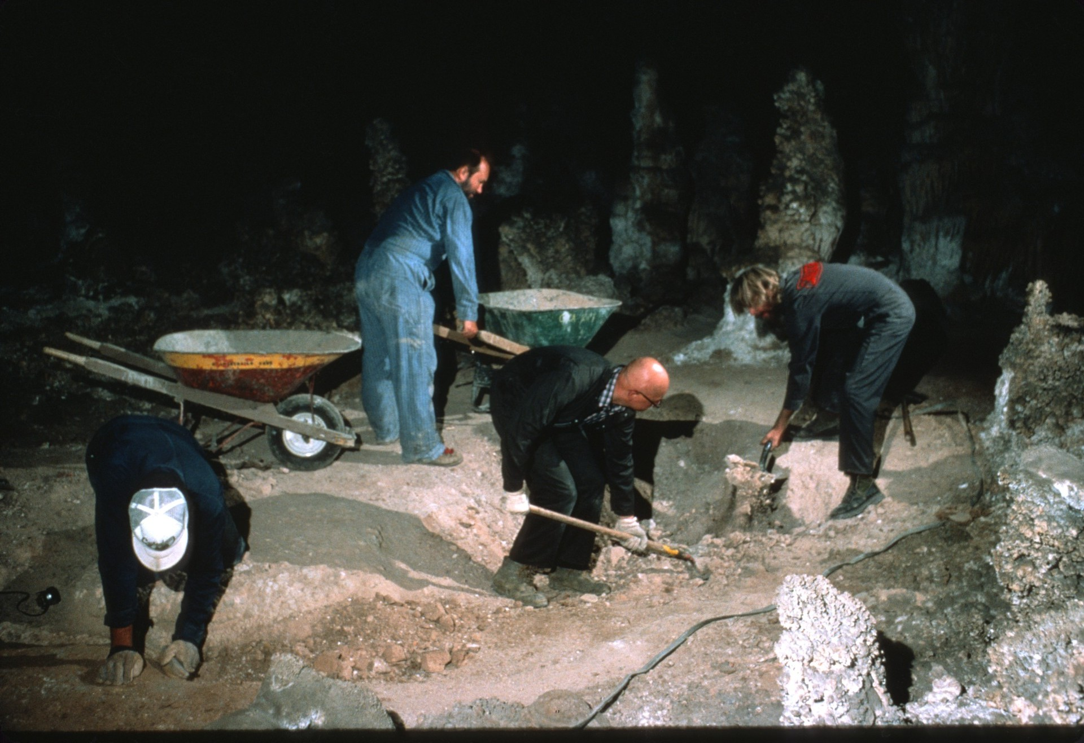
Notes:
Rimstone pools were uncovered (Before)

Slide 21
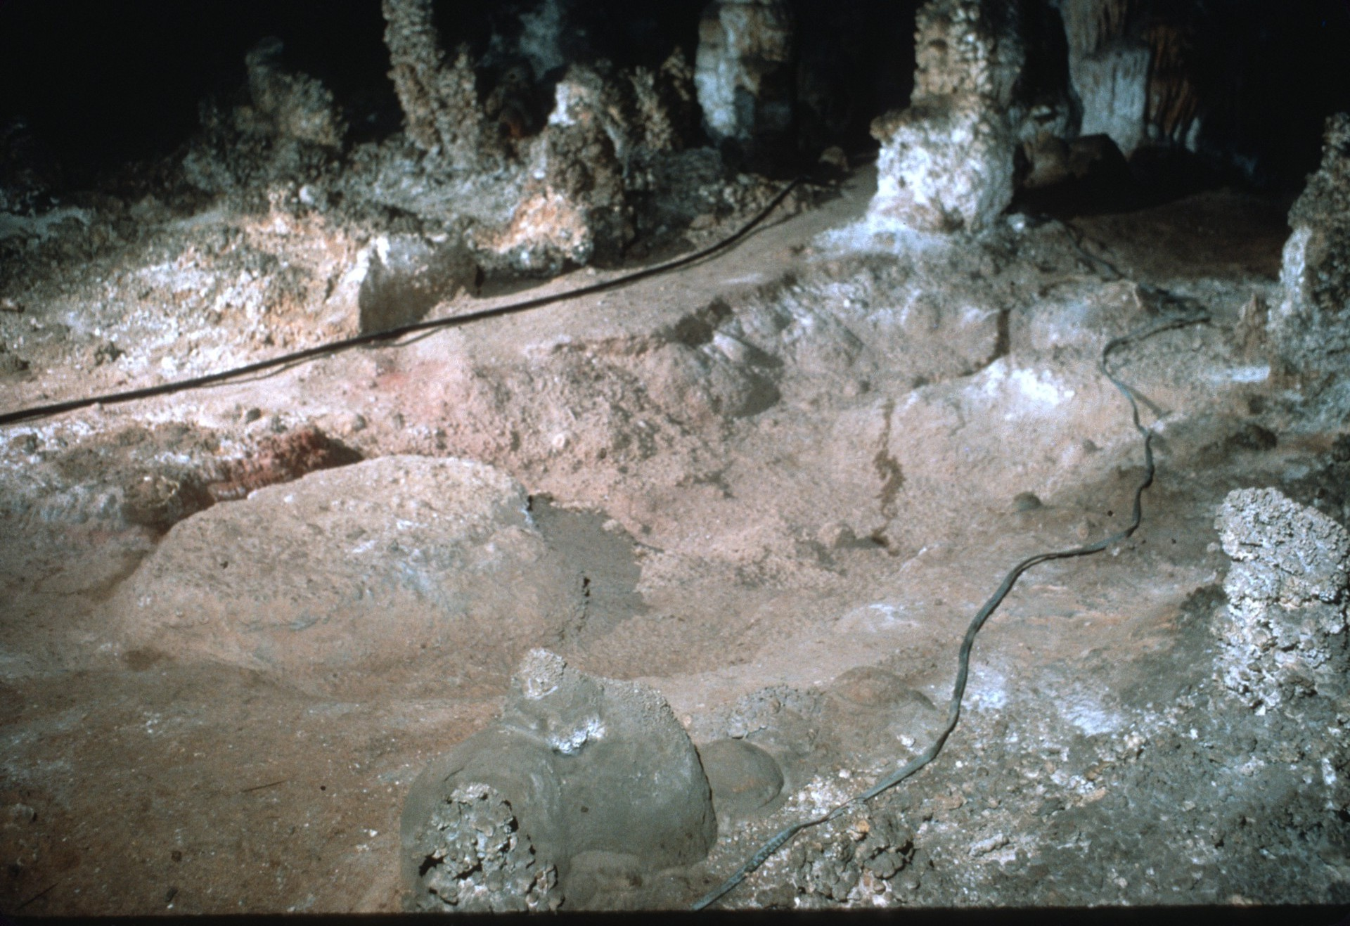
Notes:
(After)

Slide 22
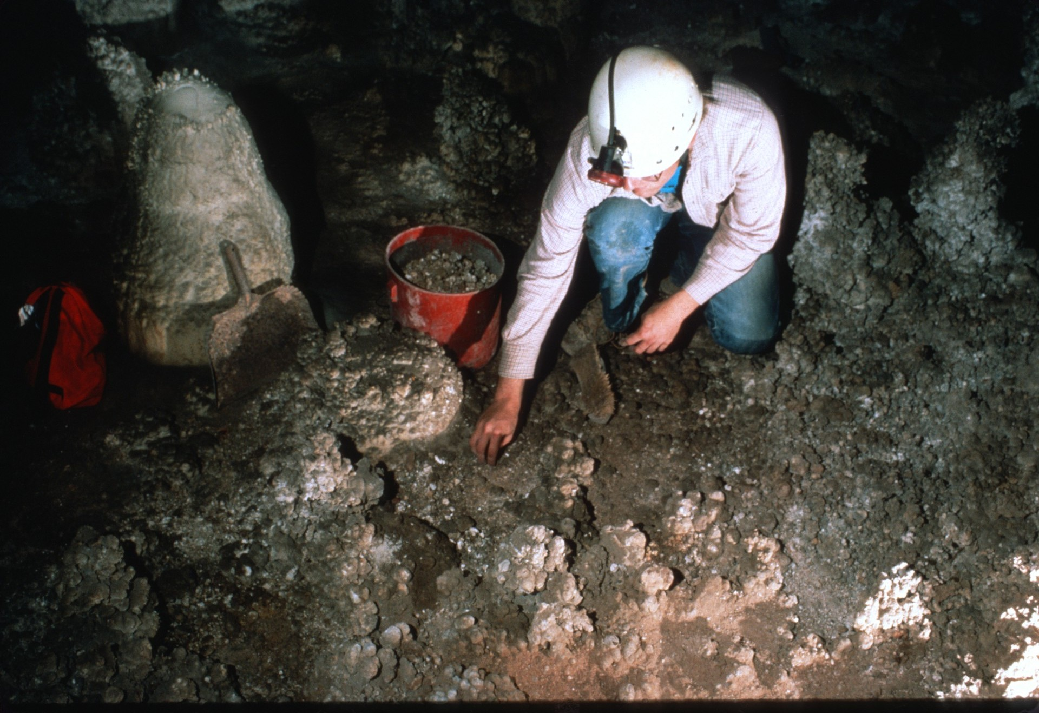
Notes:
Debris removed from the floor (Before)

Slide 23
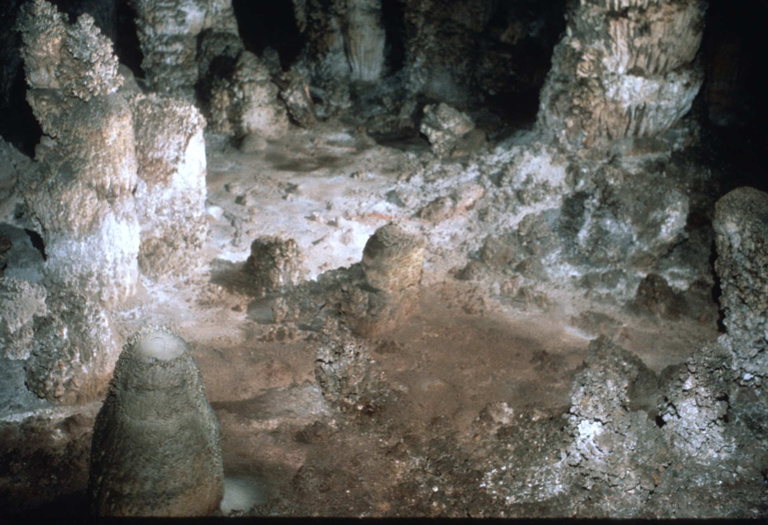
Notes:
(After)

Slide 24
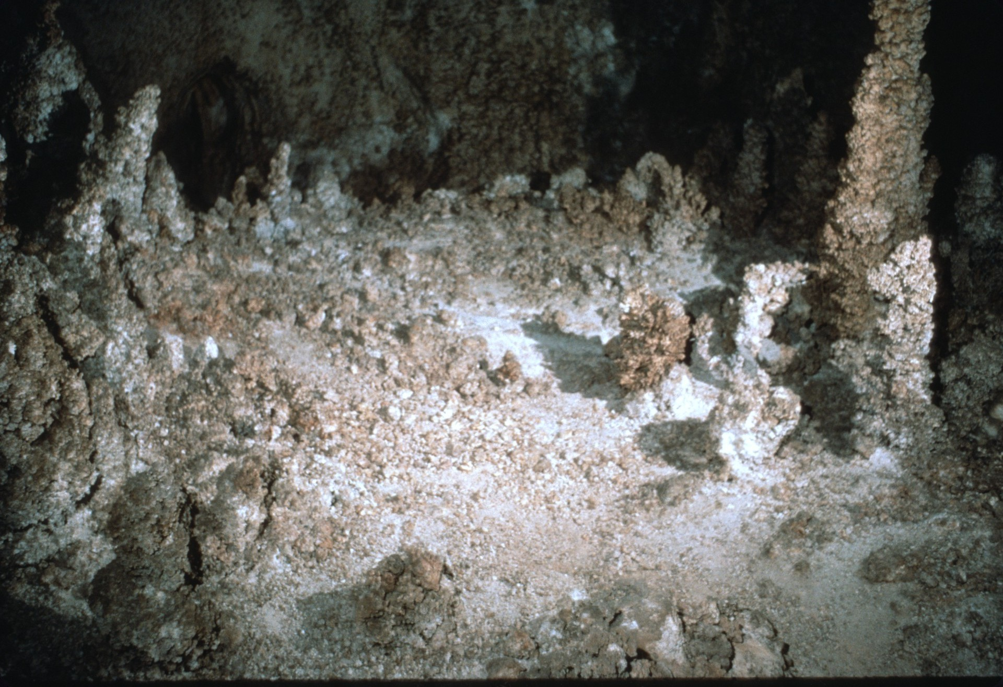
Notes:
And the cave floor returned to its natural state before trail construction (Before)

Slide 25
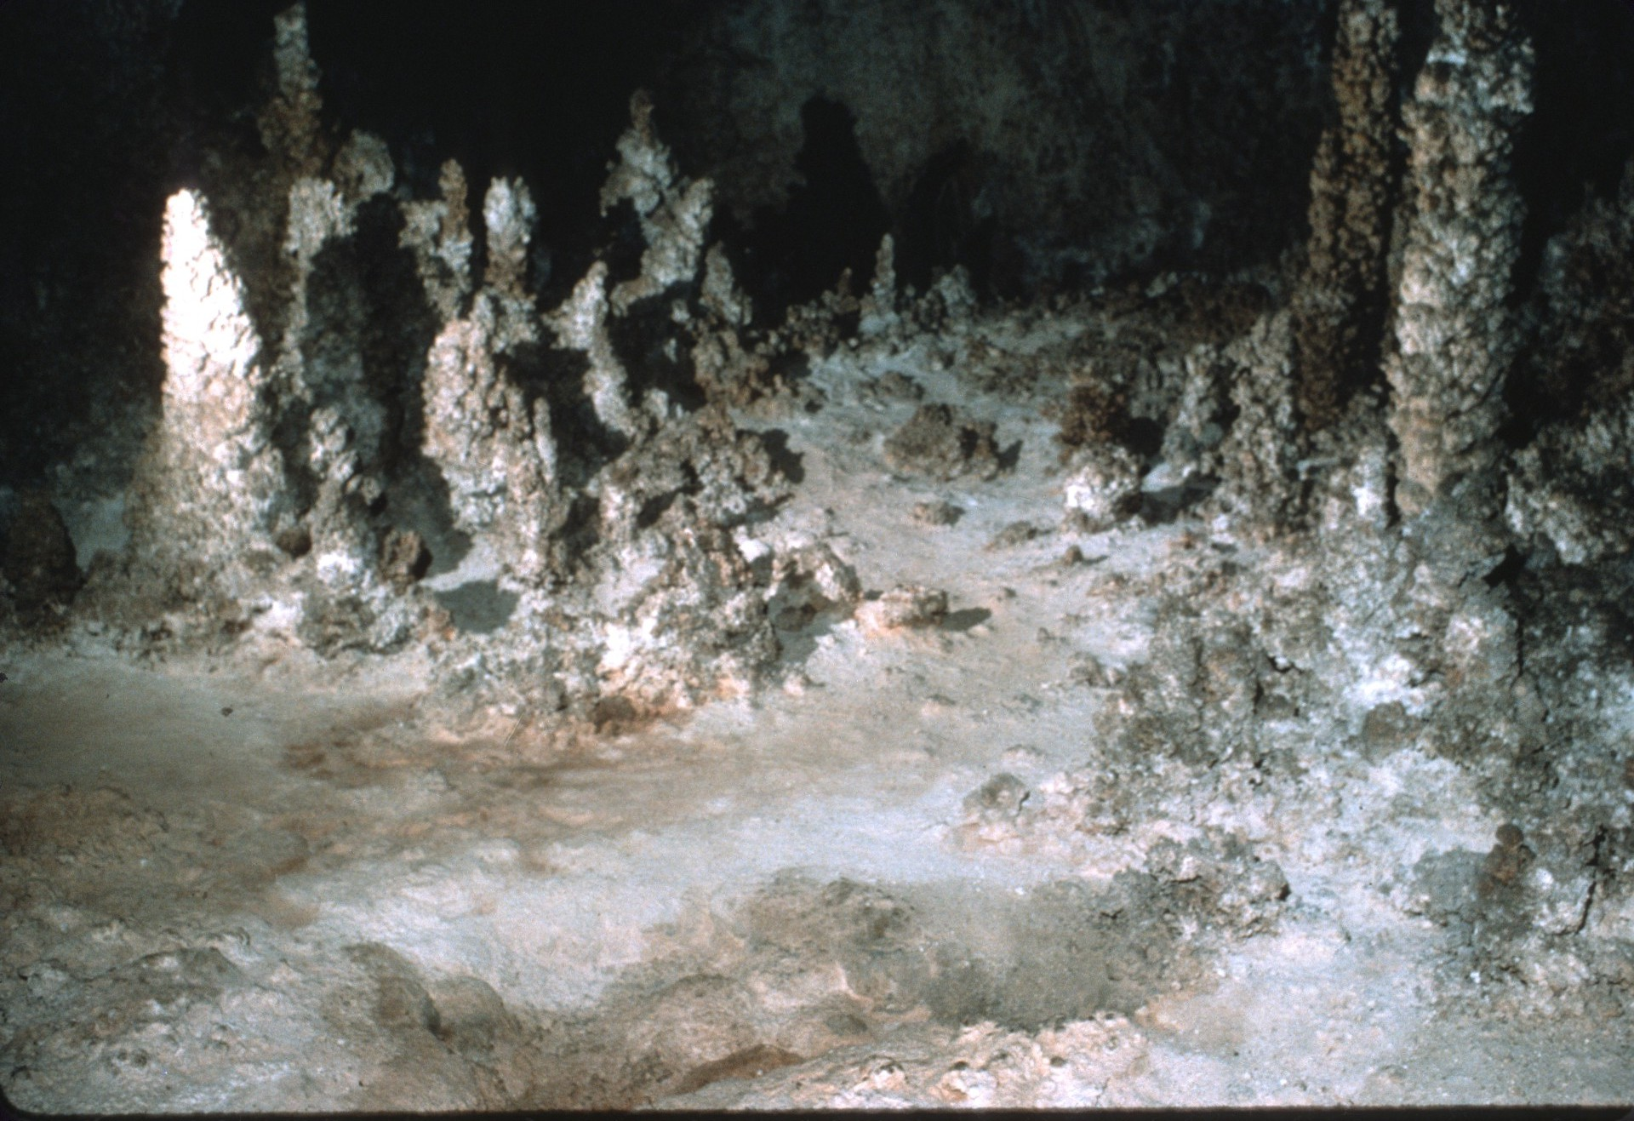
Notes:
(After)

Slide 26
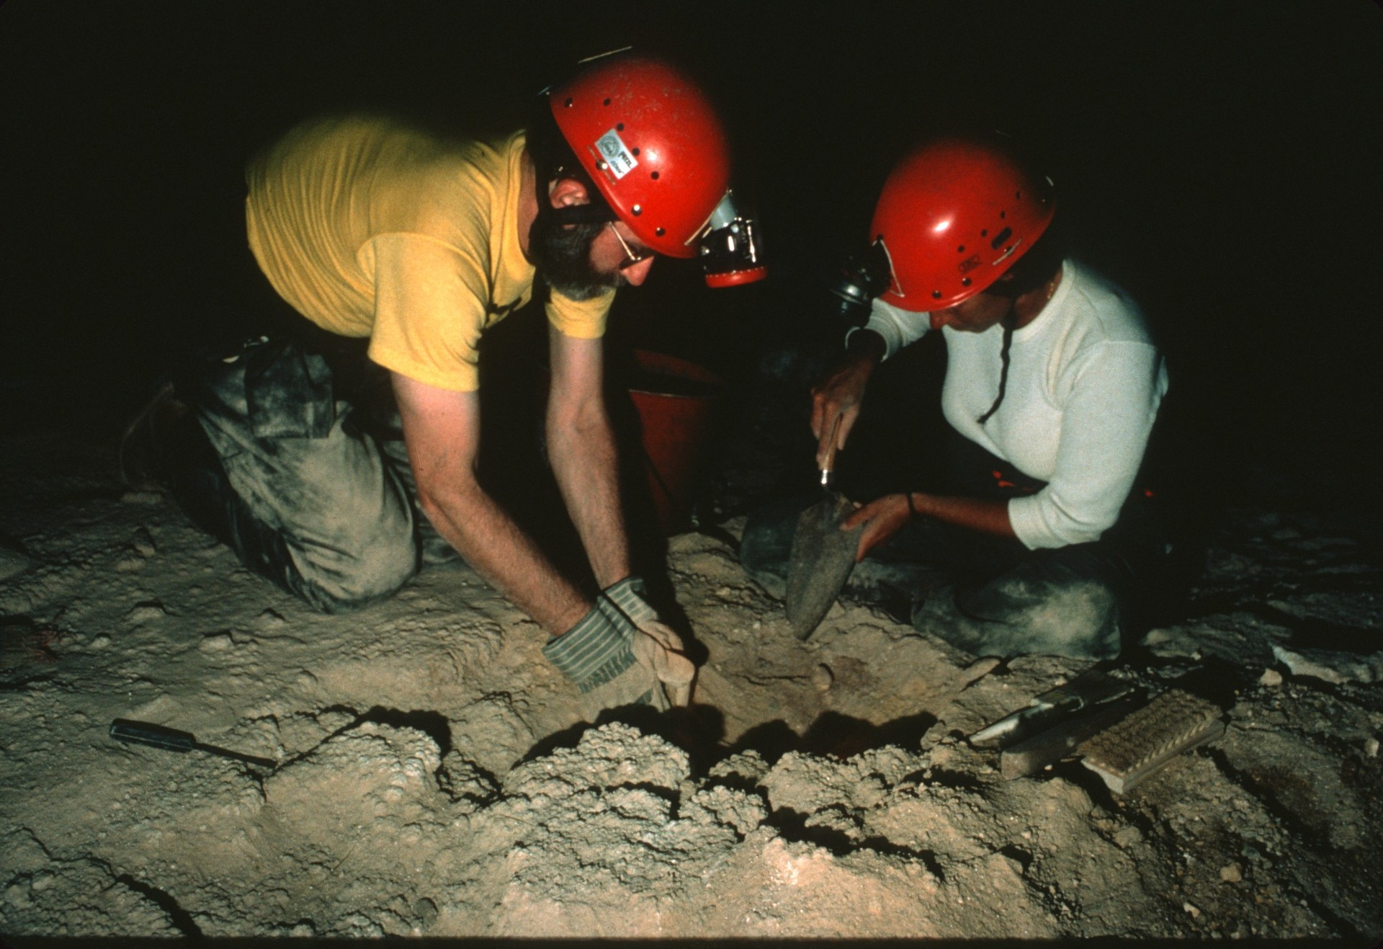
Notes:
Much had changed as a result of our efforts (Before)

Slide 27
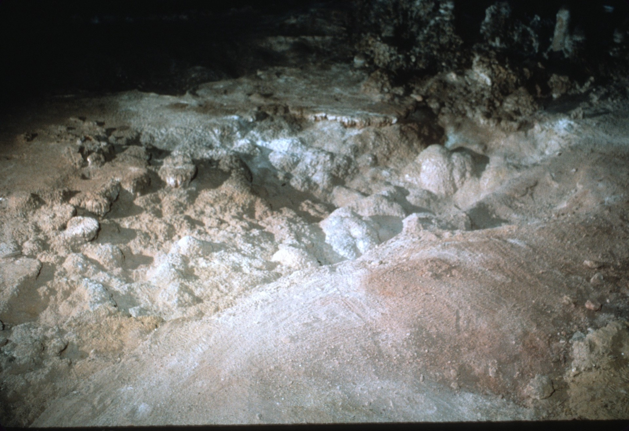
Notes:
(After)

Slide 28
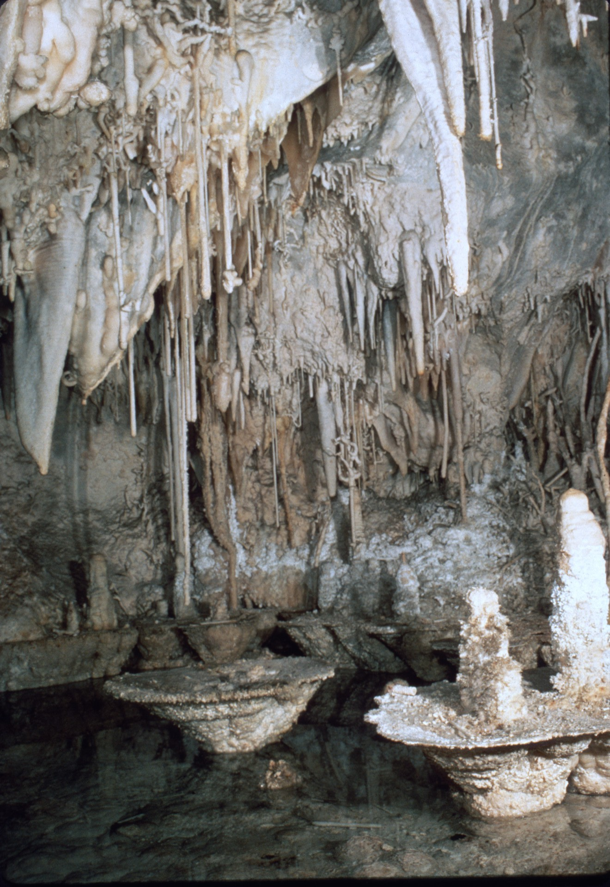
Notes:
While we worked during the day, Ron let us see some of the wild portions of the cave by night.

Slide 29
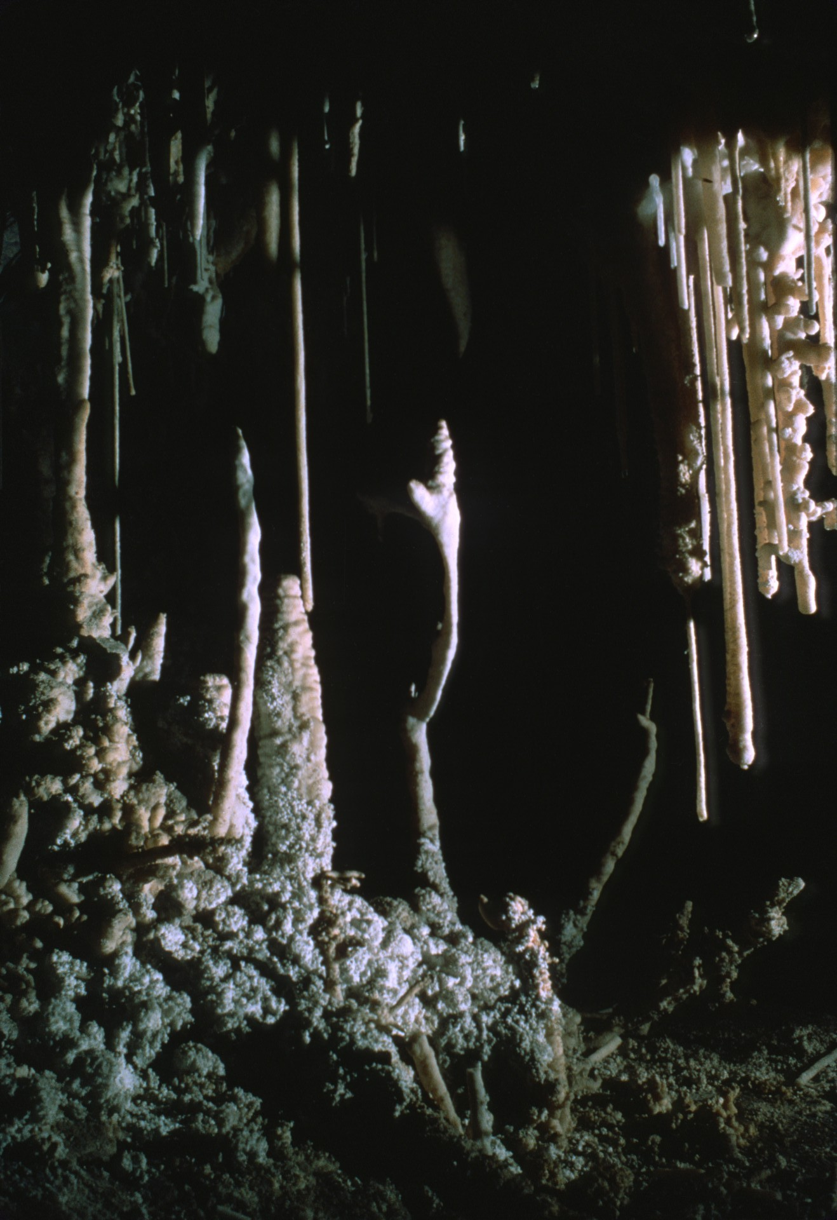
Notes:
One evening we explored the Left Hand Tunnel, seeing the Vegetable Patch along the way.

Slide 30
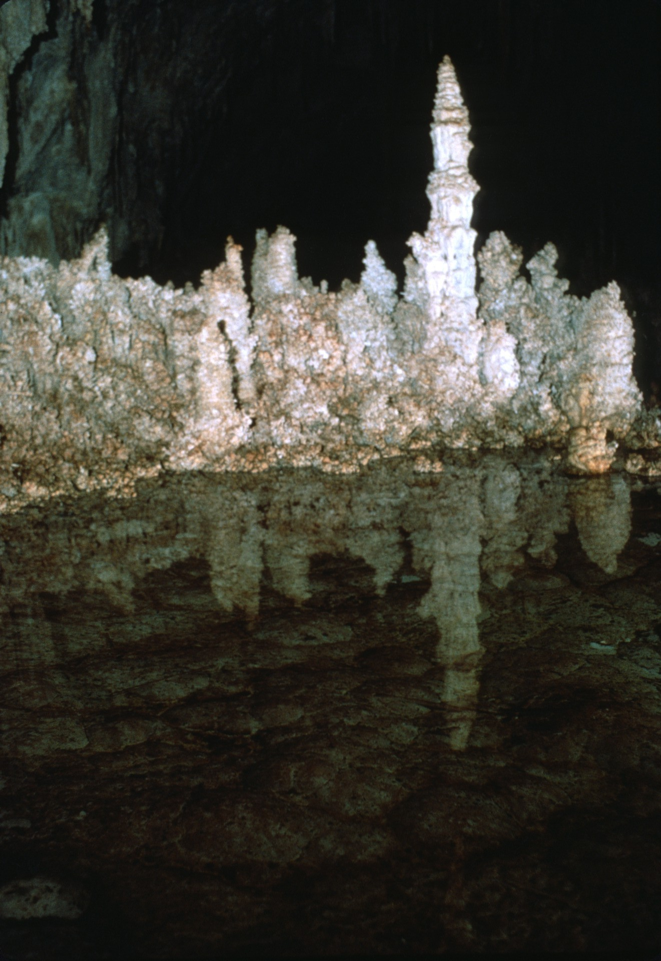
Notes:
We passed by several small pools and

Slide 31
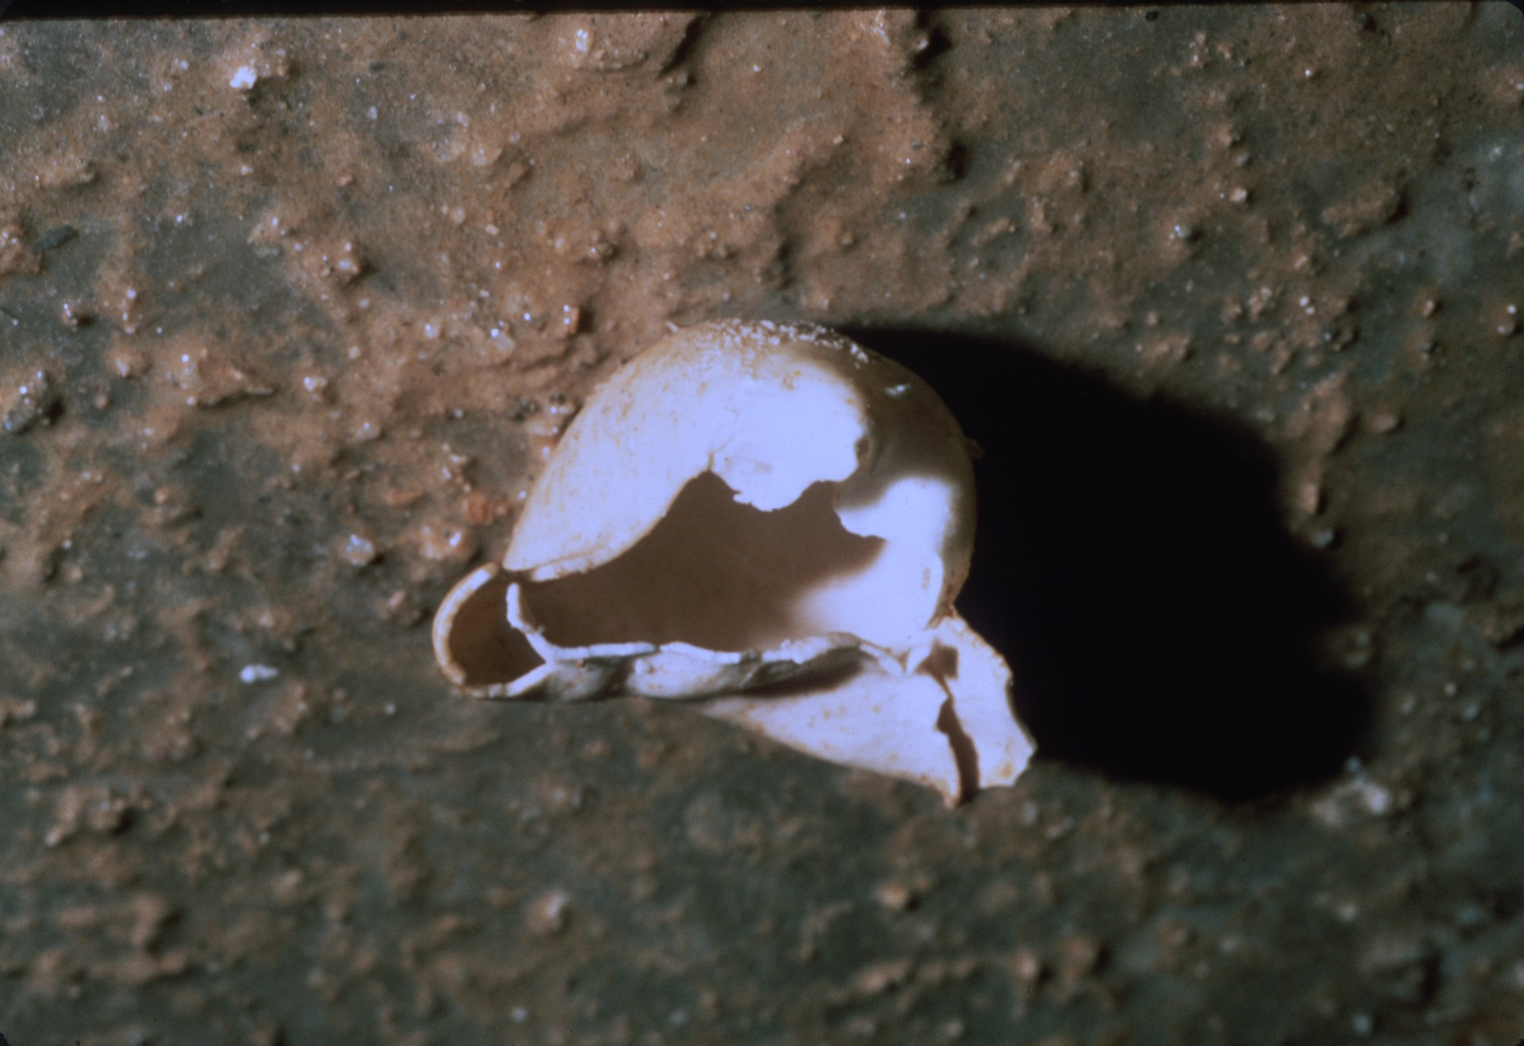
Notes:
a blister lying on the floor.

Slide 32
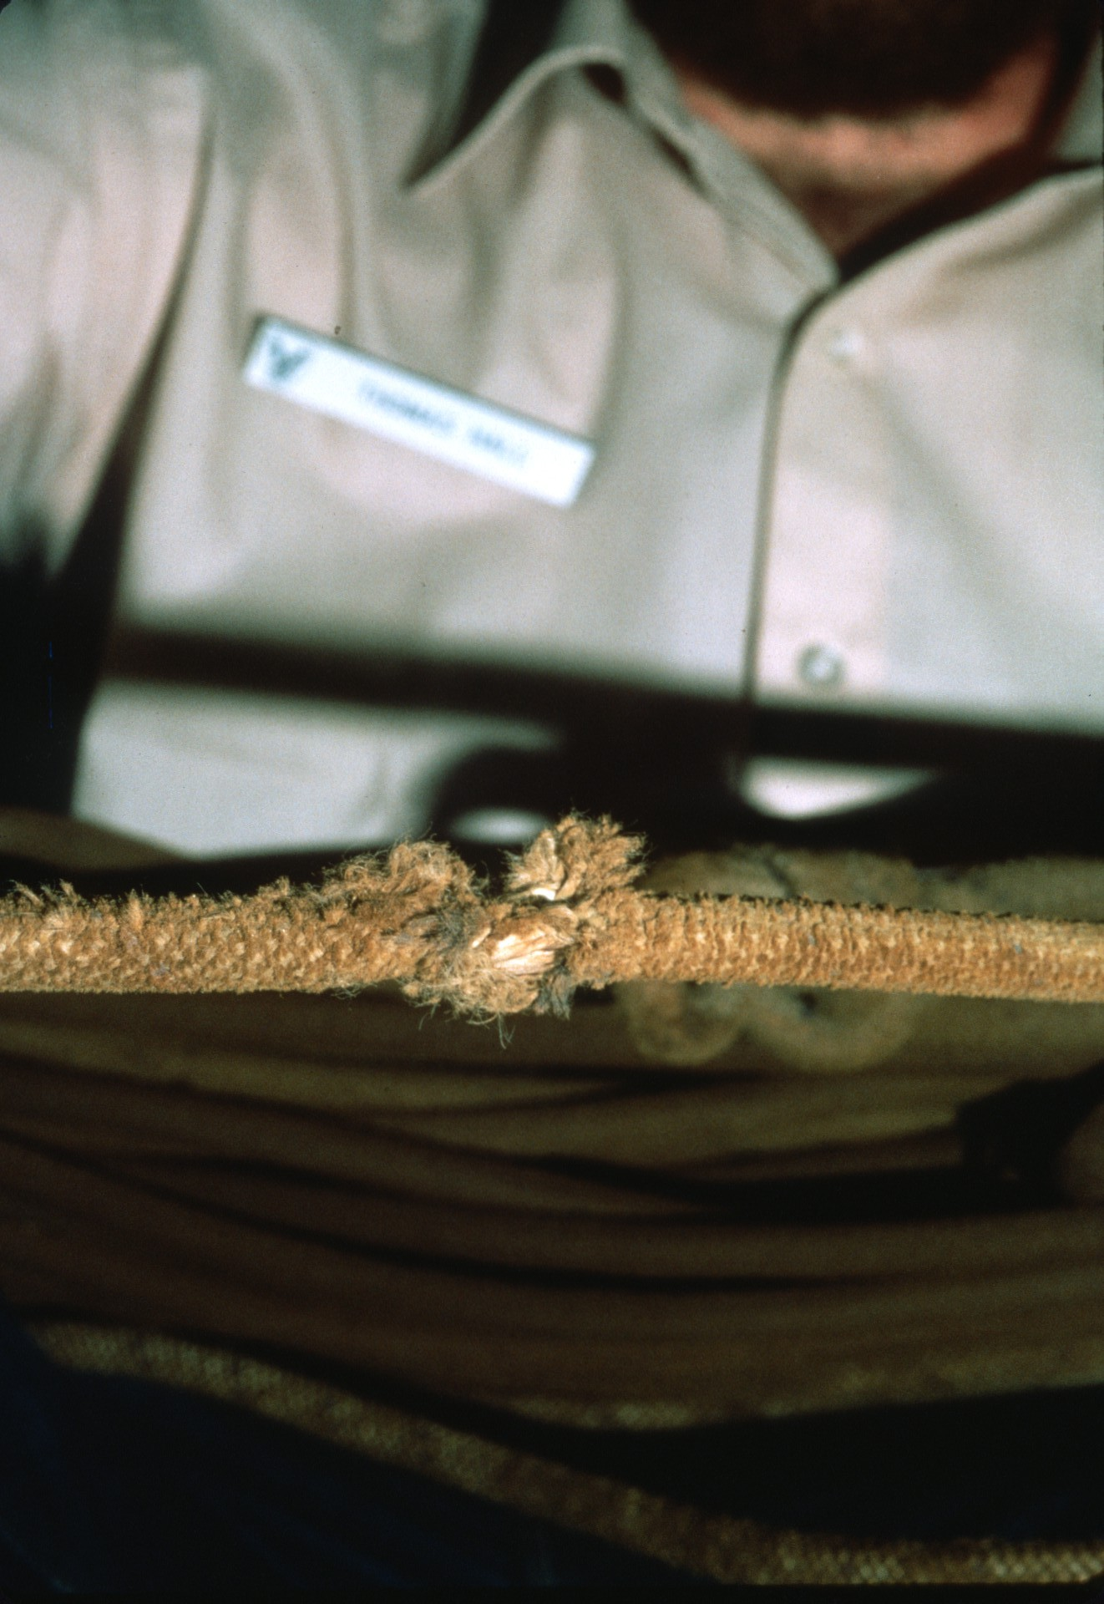
Notes:
One of our tasks was to retrieve the old rope on the drop to Lake of the Clouds. It definitely needed replacing!

Slide 33
Notes:
We tied off a new rope and started down the first of the 300 foot drop.

Slide 34
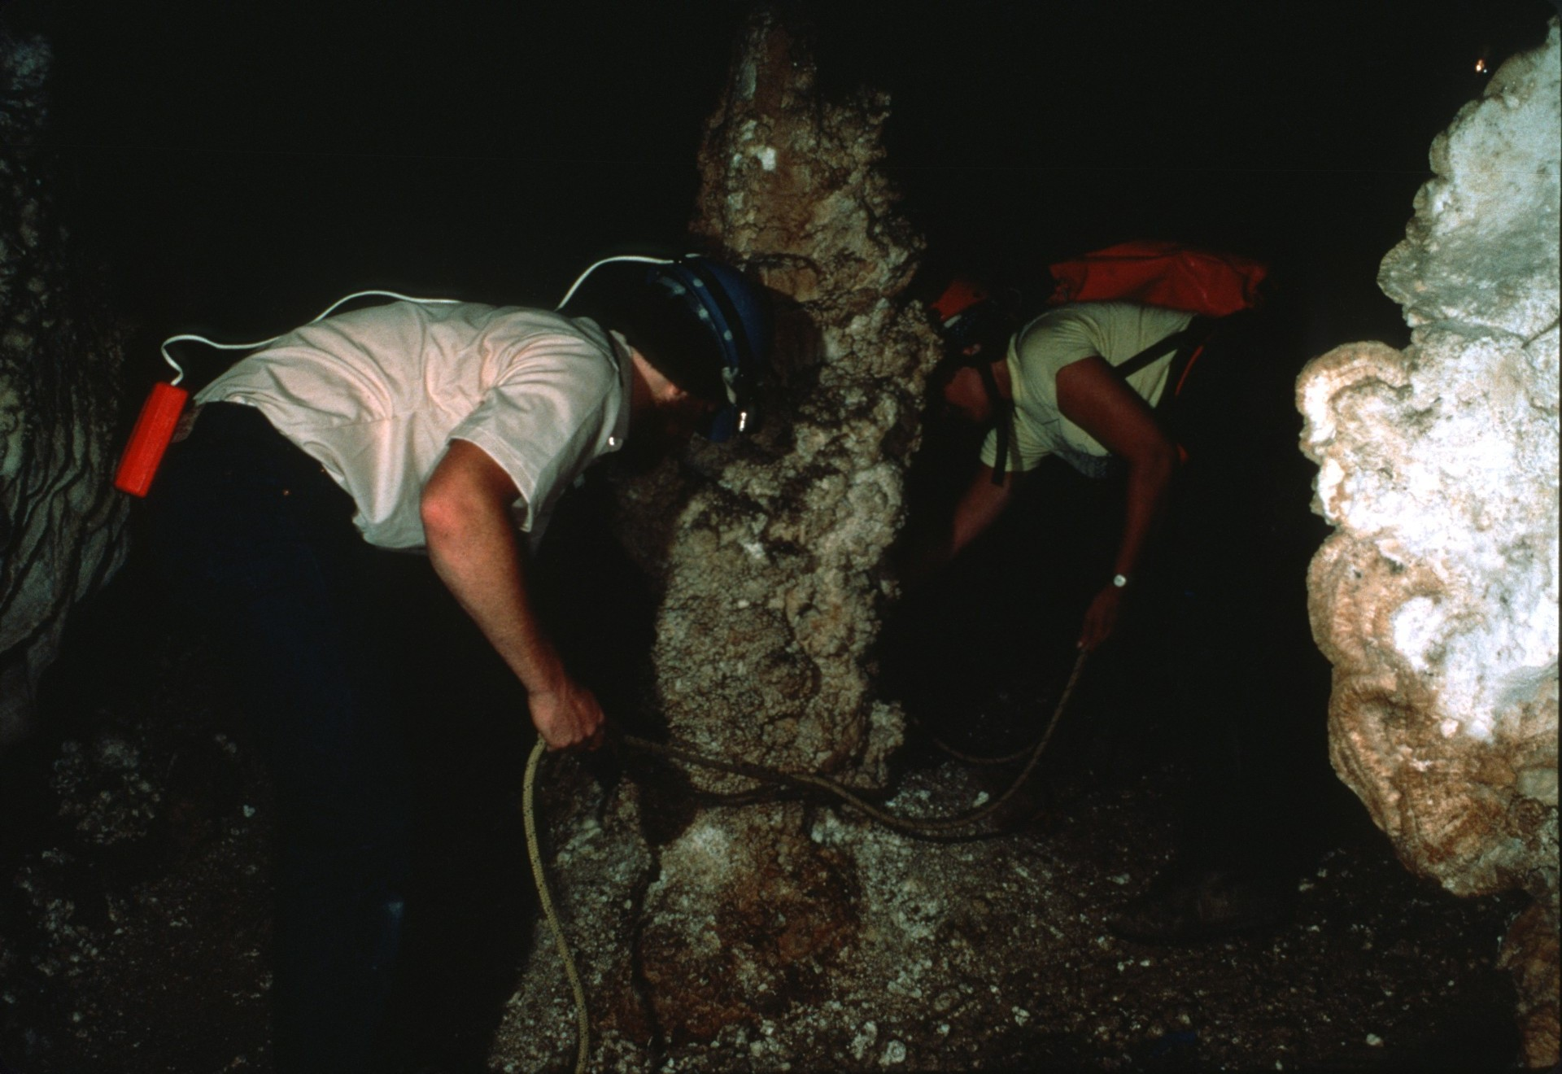

Slide 36
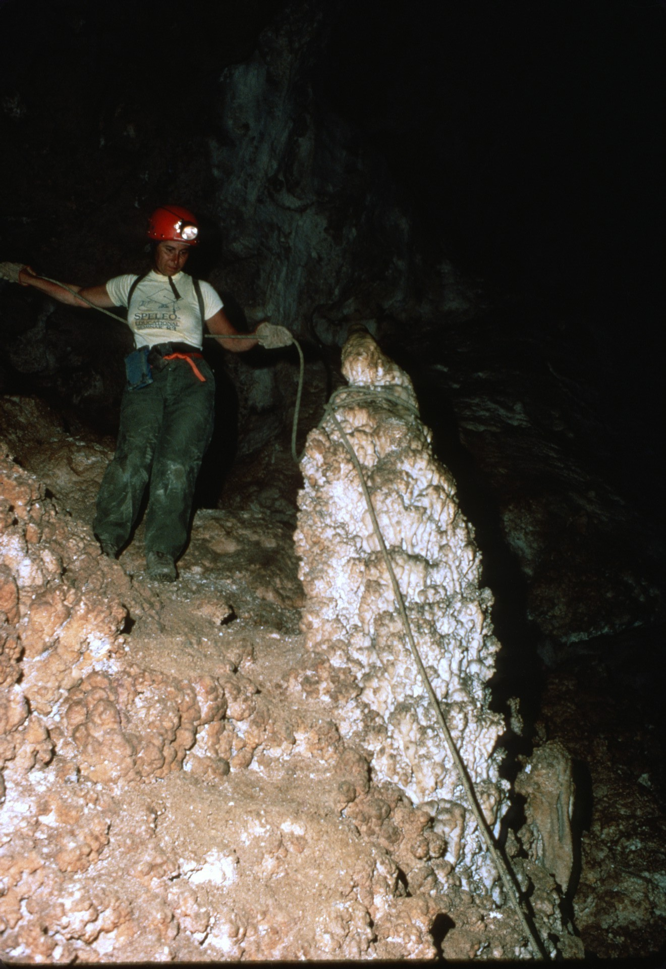

Slide 37
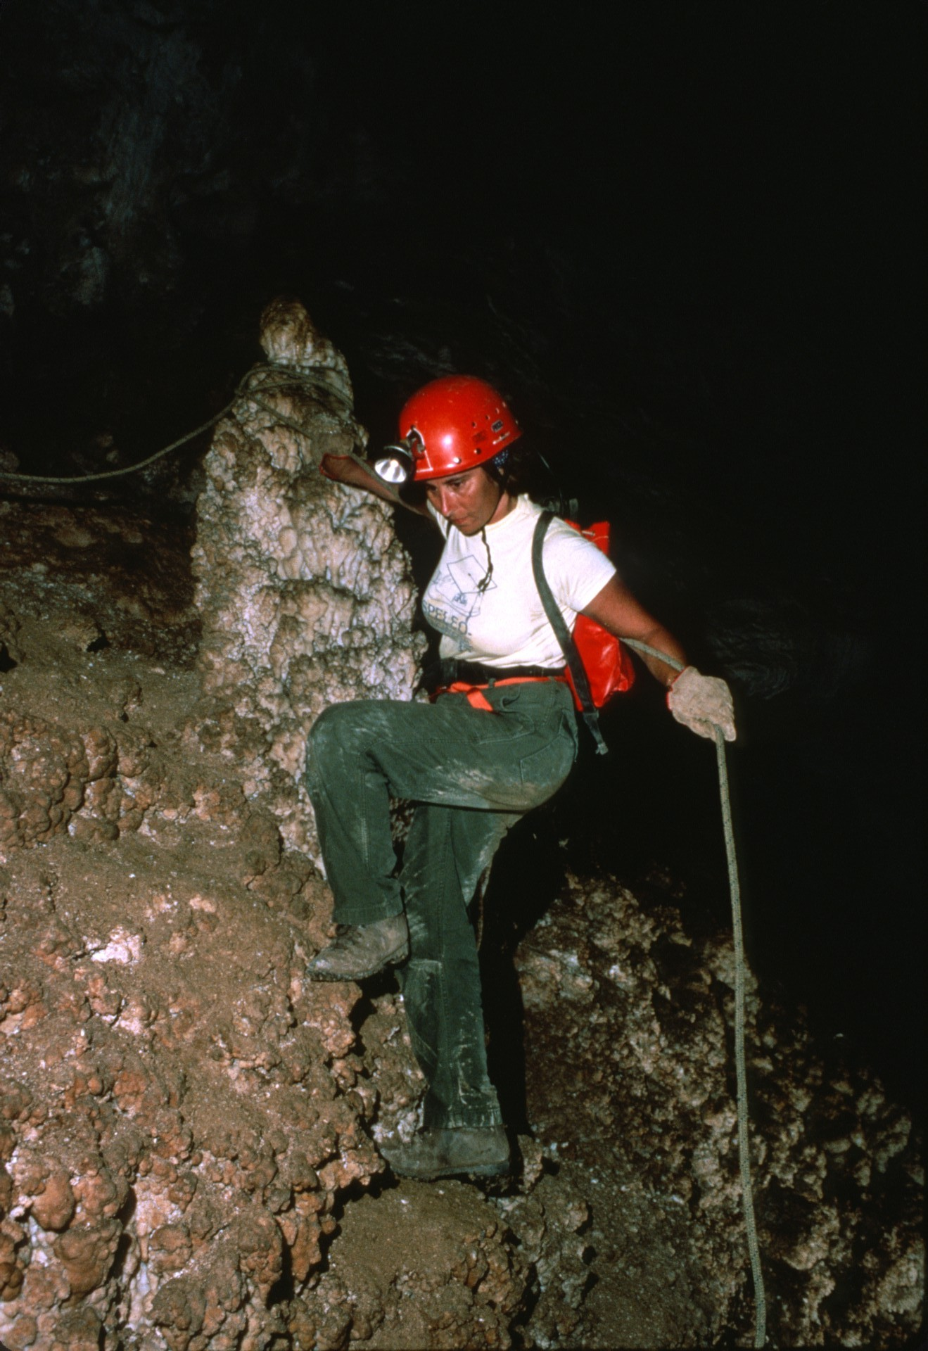

Slide 38
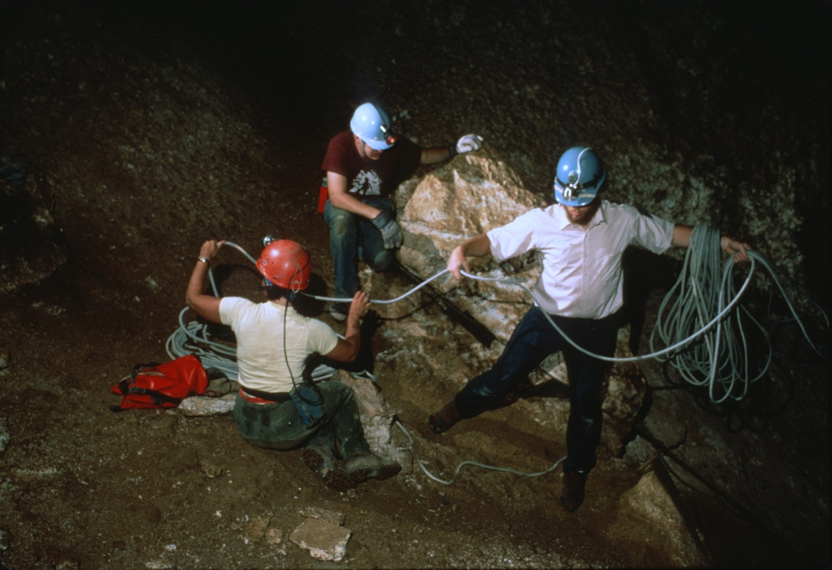
Notes:
Midway down the drop there was a wide ledge.

Slide 39
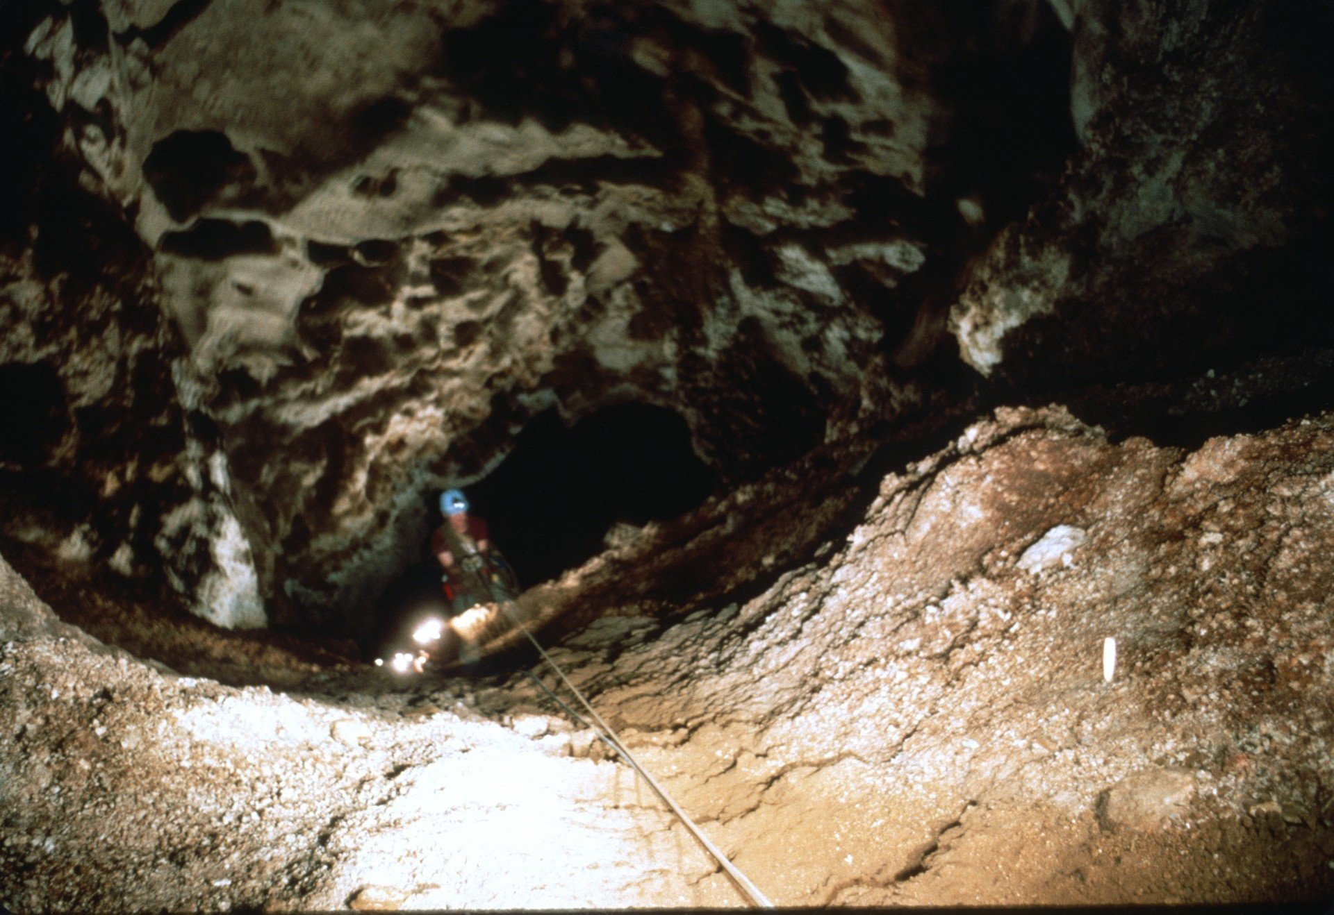
Notes:
We tied off a second rope and continued down.

Slide 40
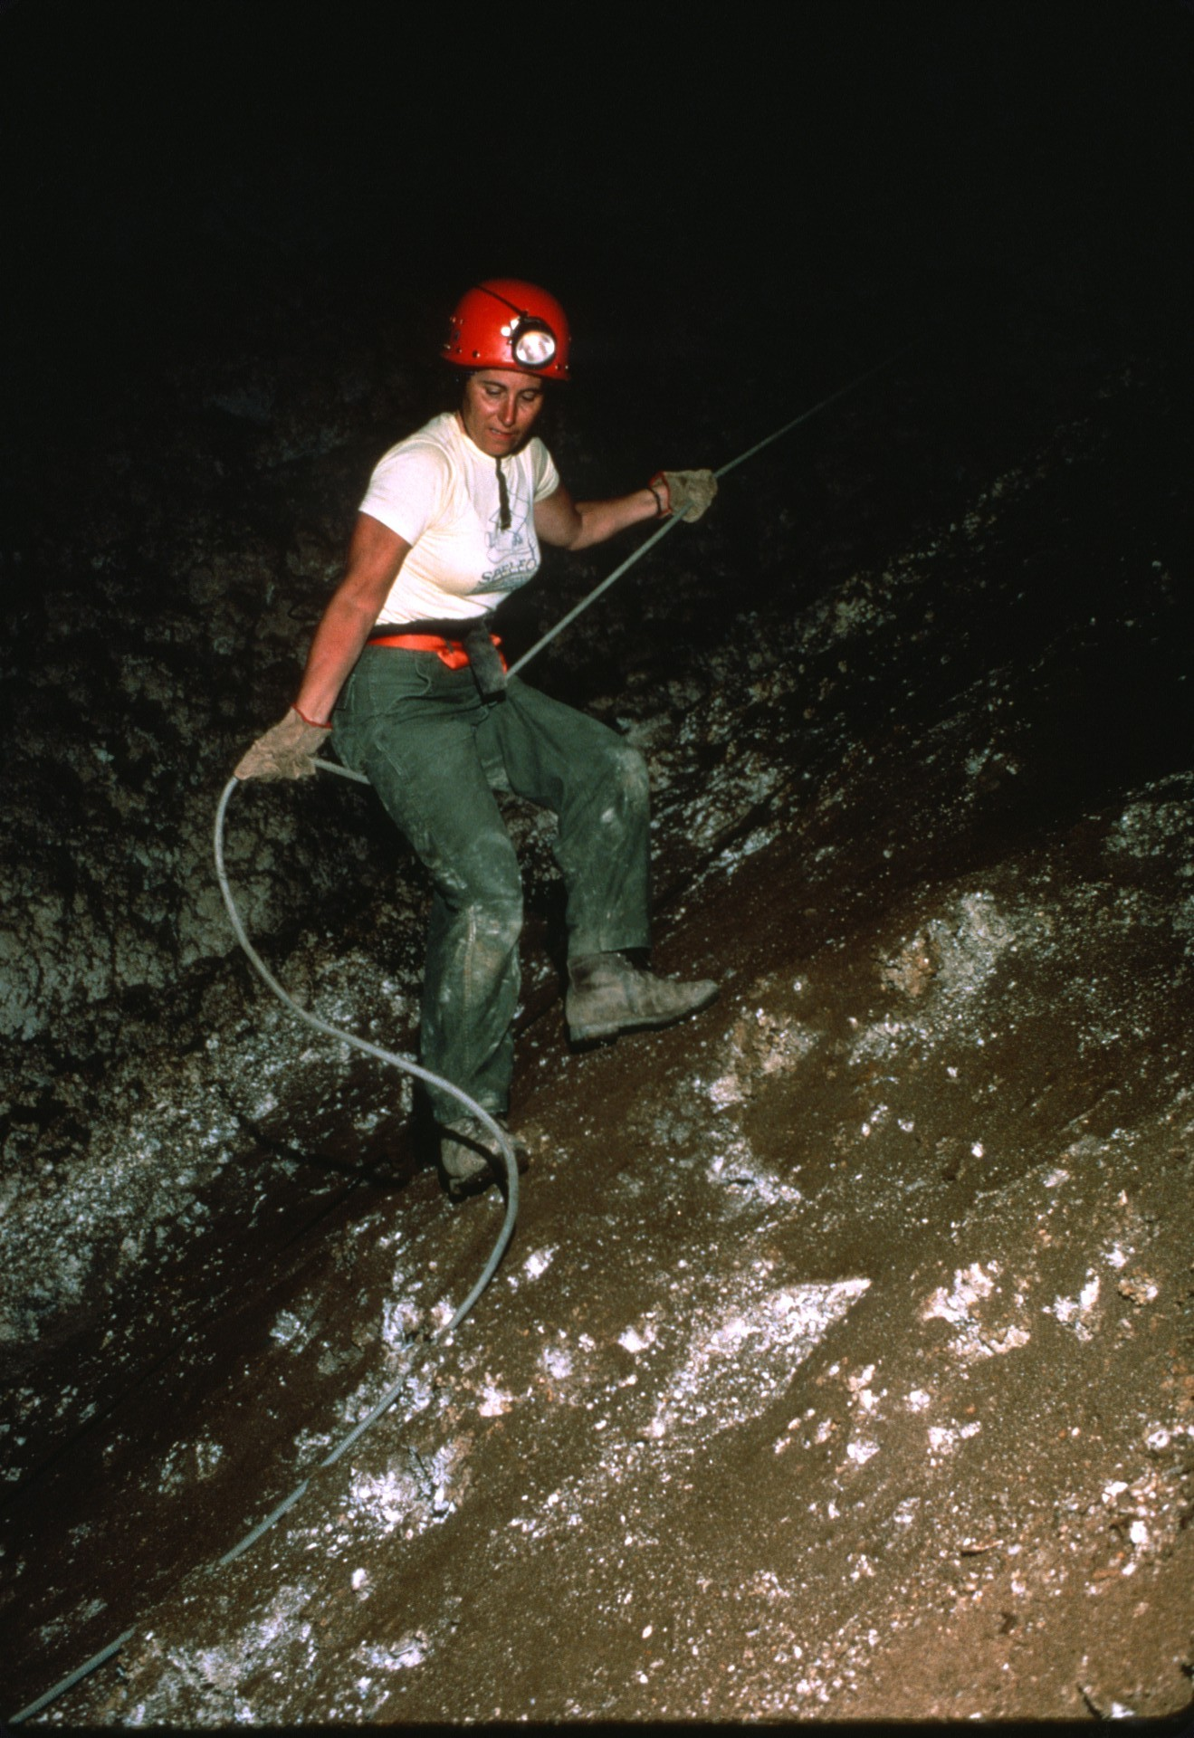
Notes:
The drop was steep,

Slide 41
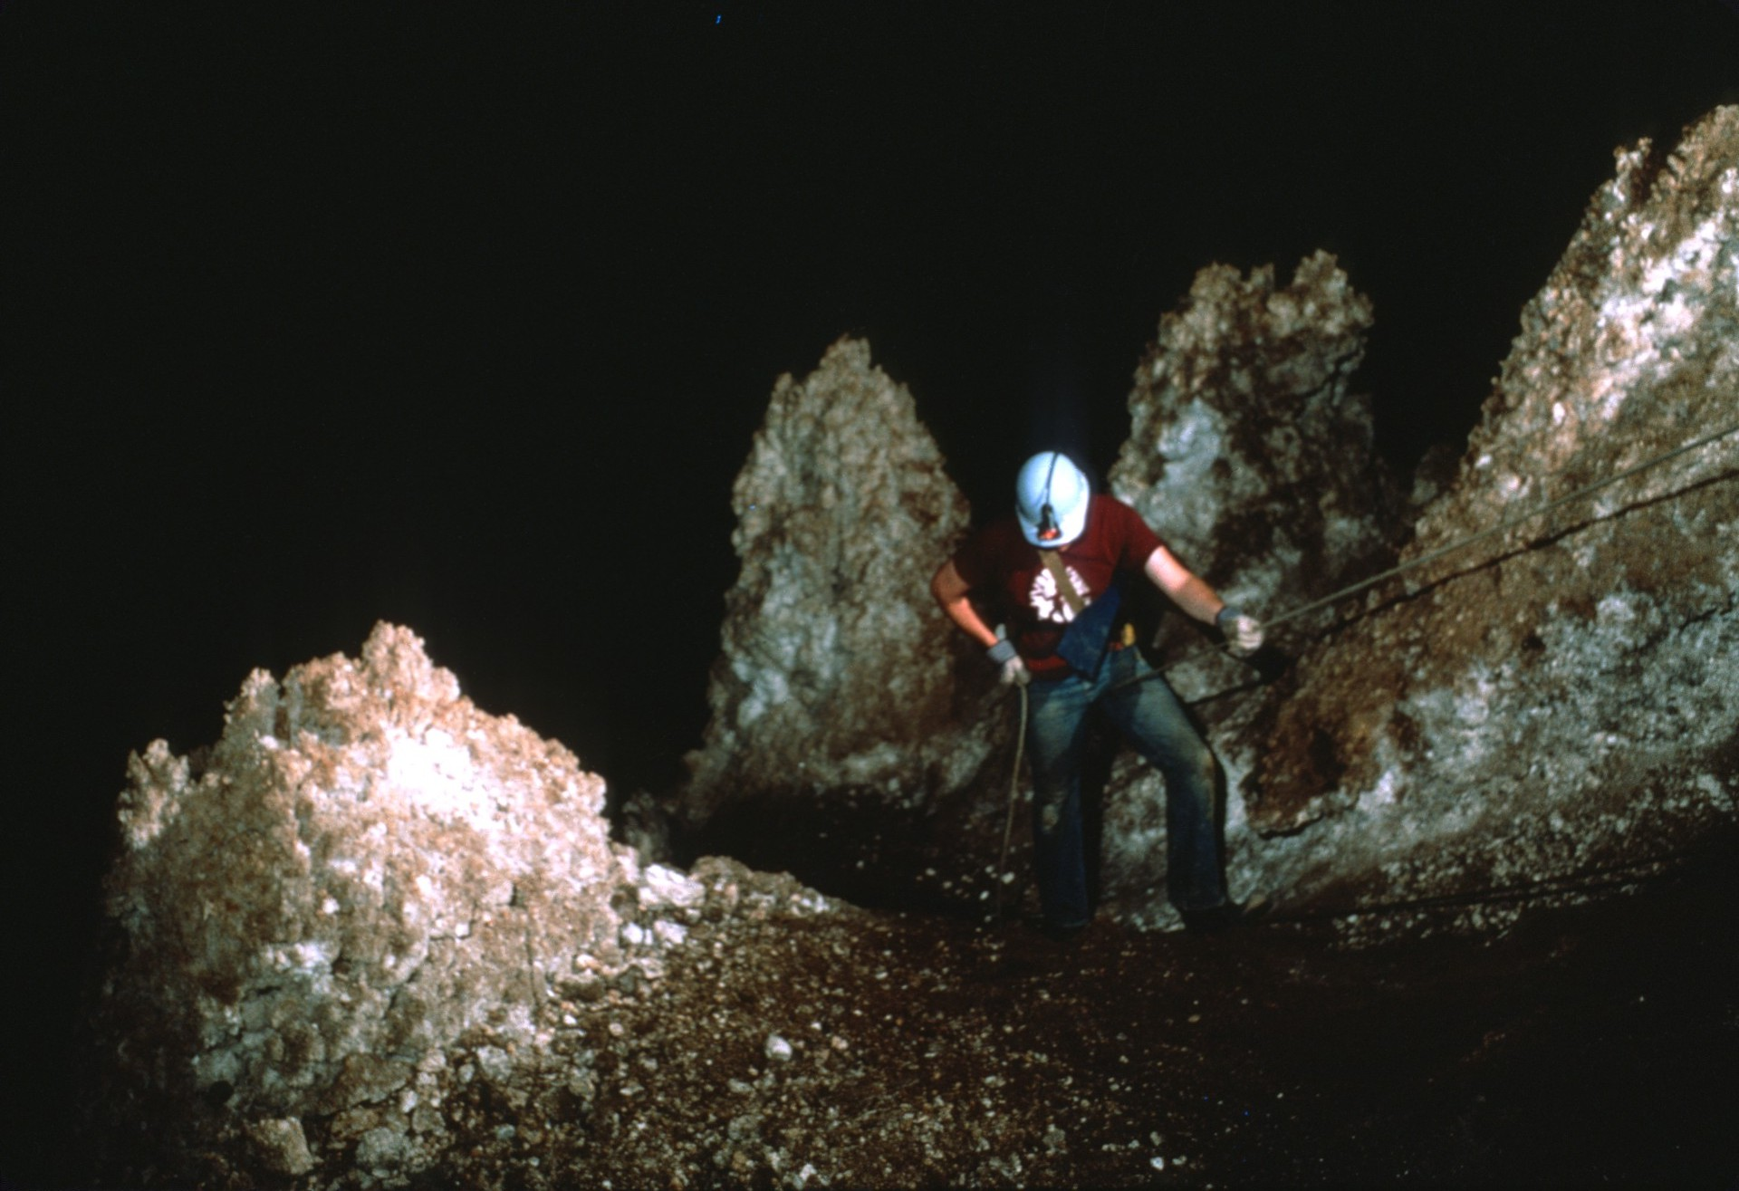
Notes:
but the rope was only needed as a handline.

Slide 42
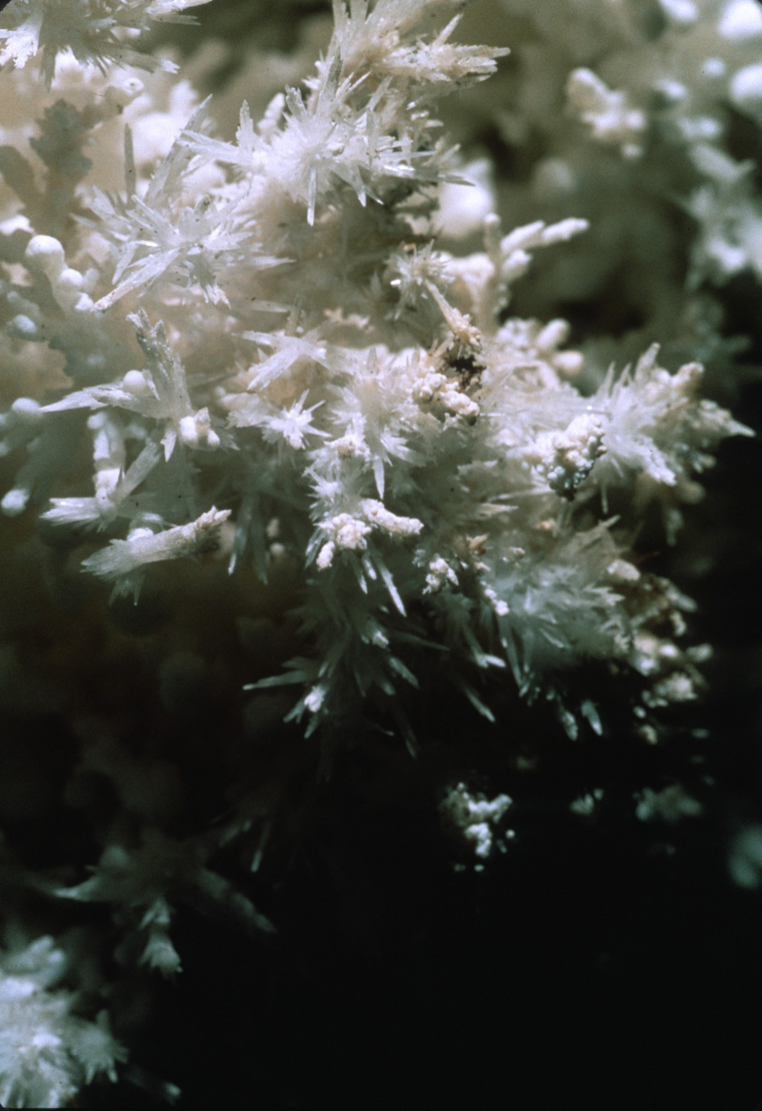
Notes:
We carefully stayed on a narrow path between formations along the way.

Slide 43
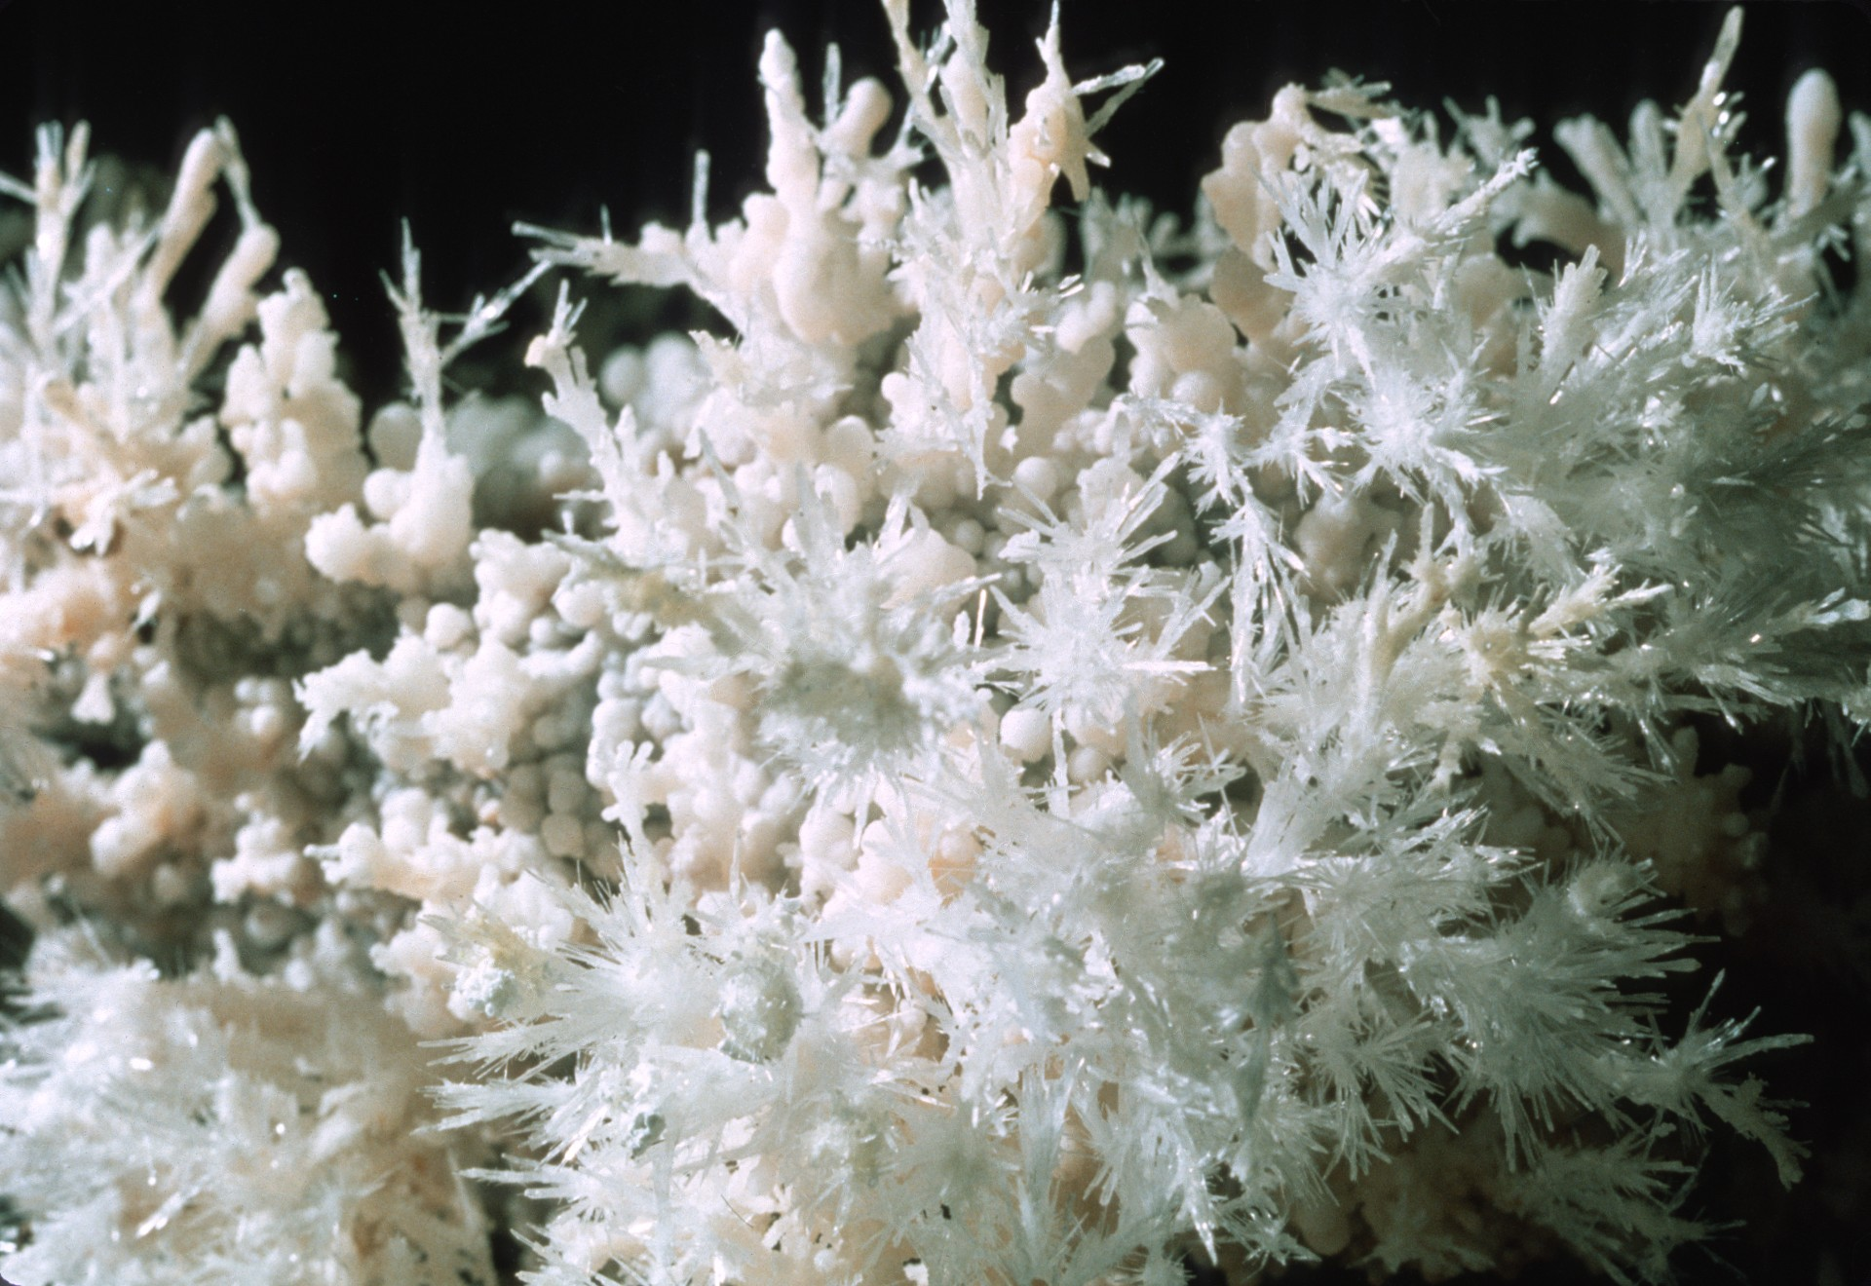

Slide 44
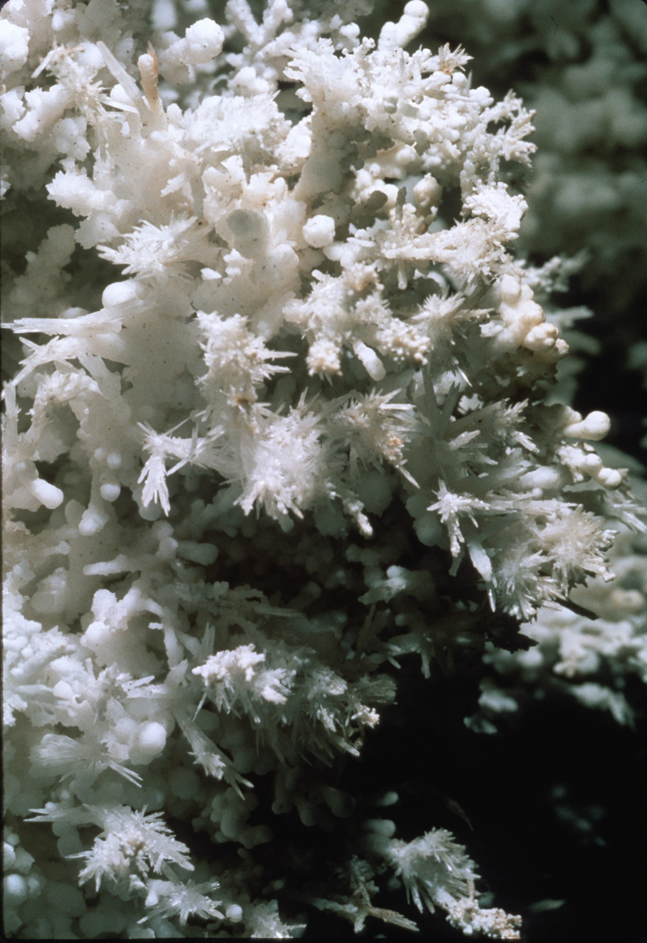

Slide 45
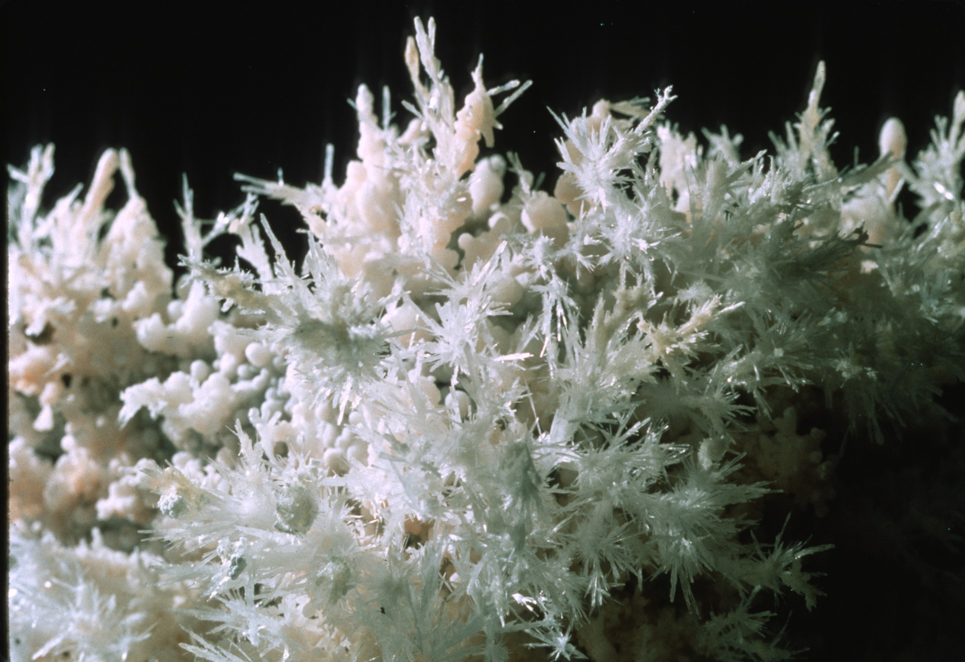

Slide 46
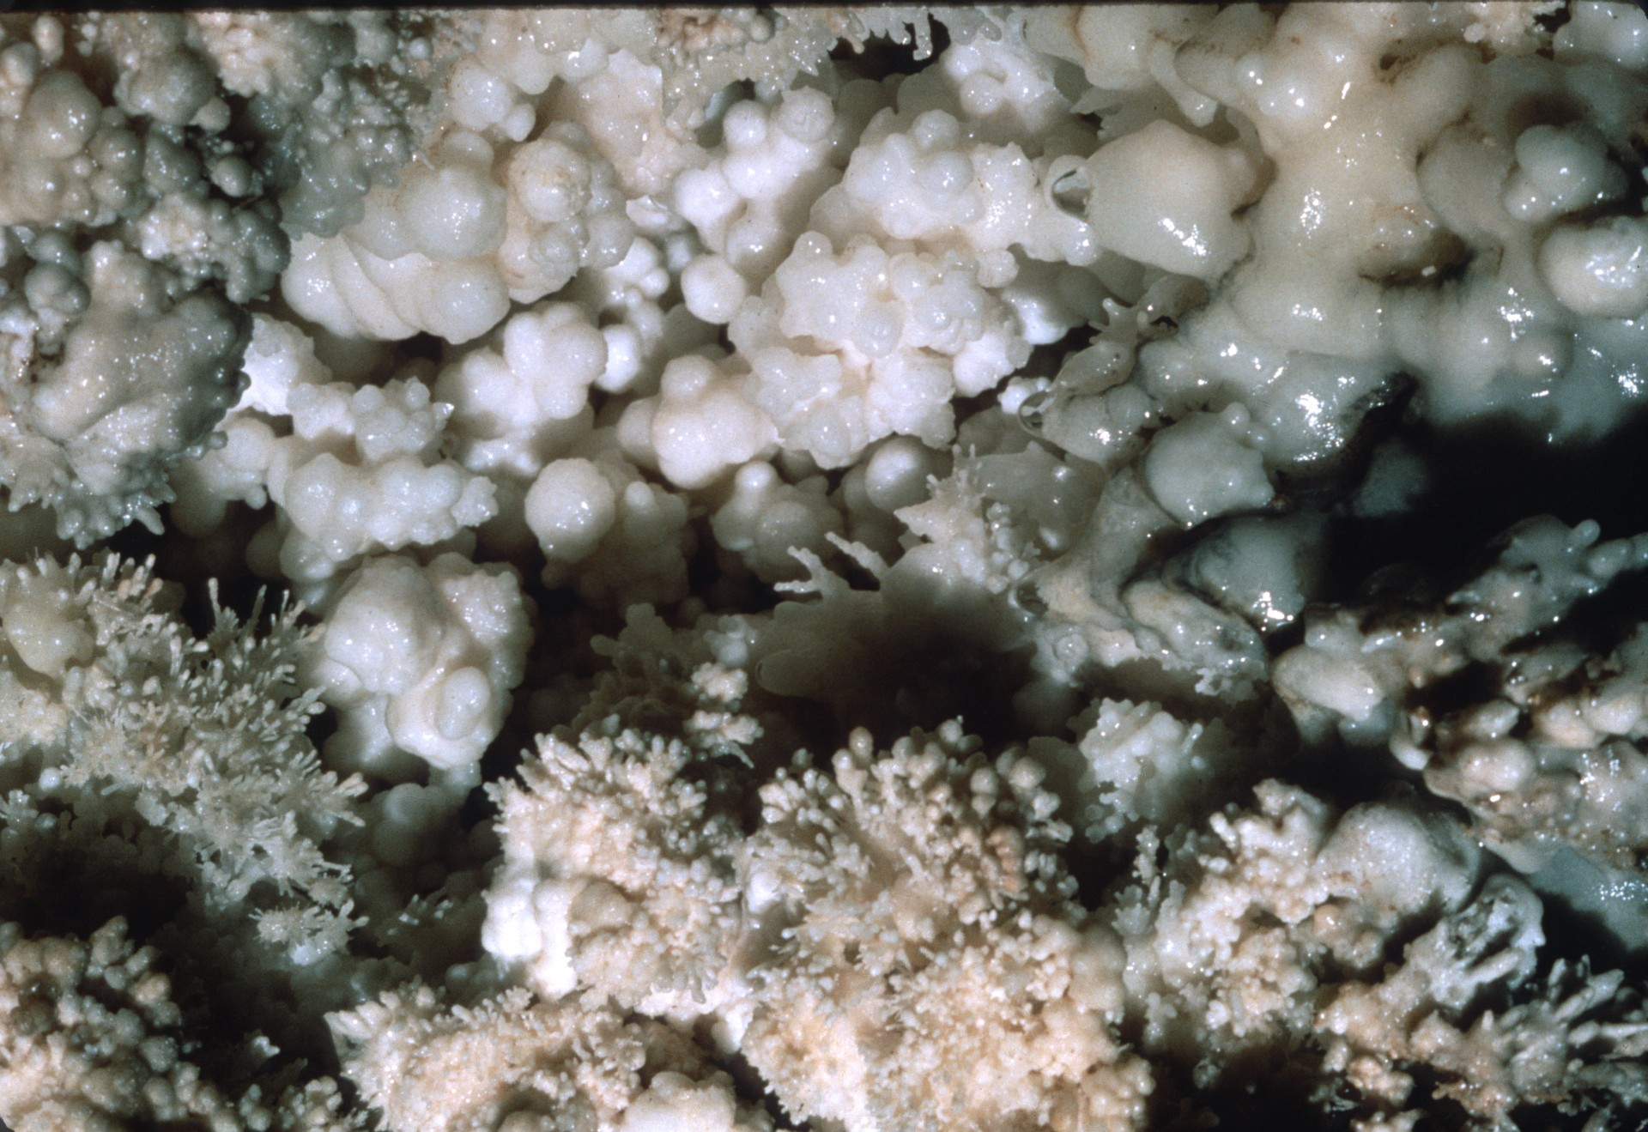

Slide 47
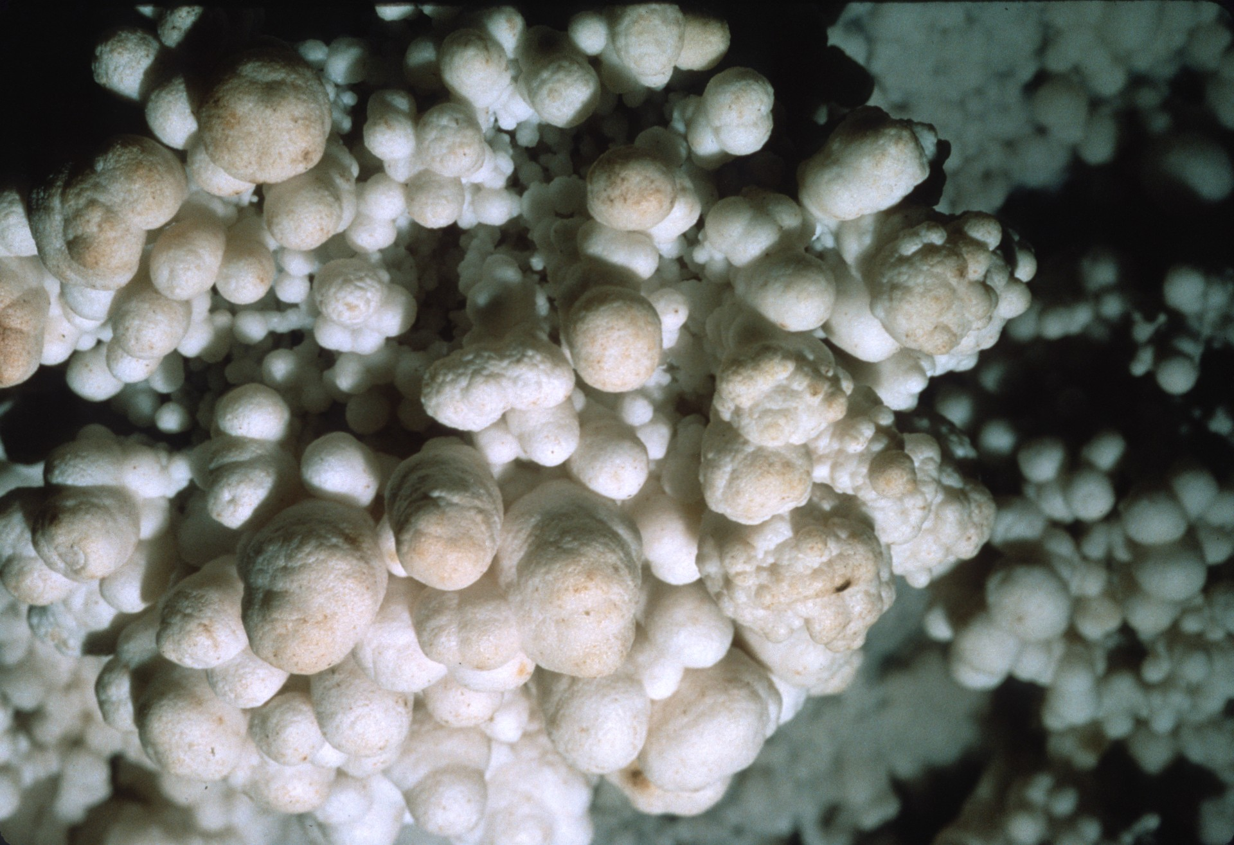

Slide 48
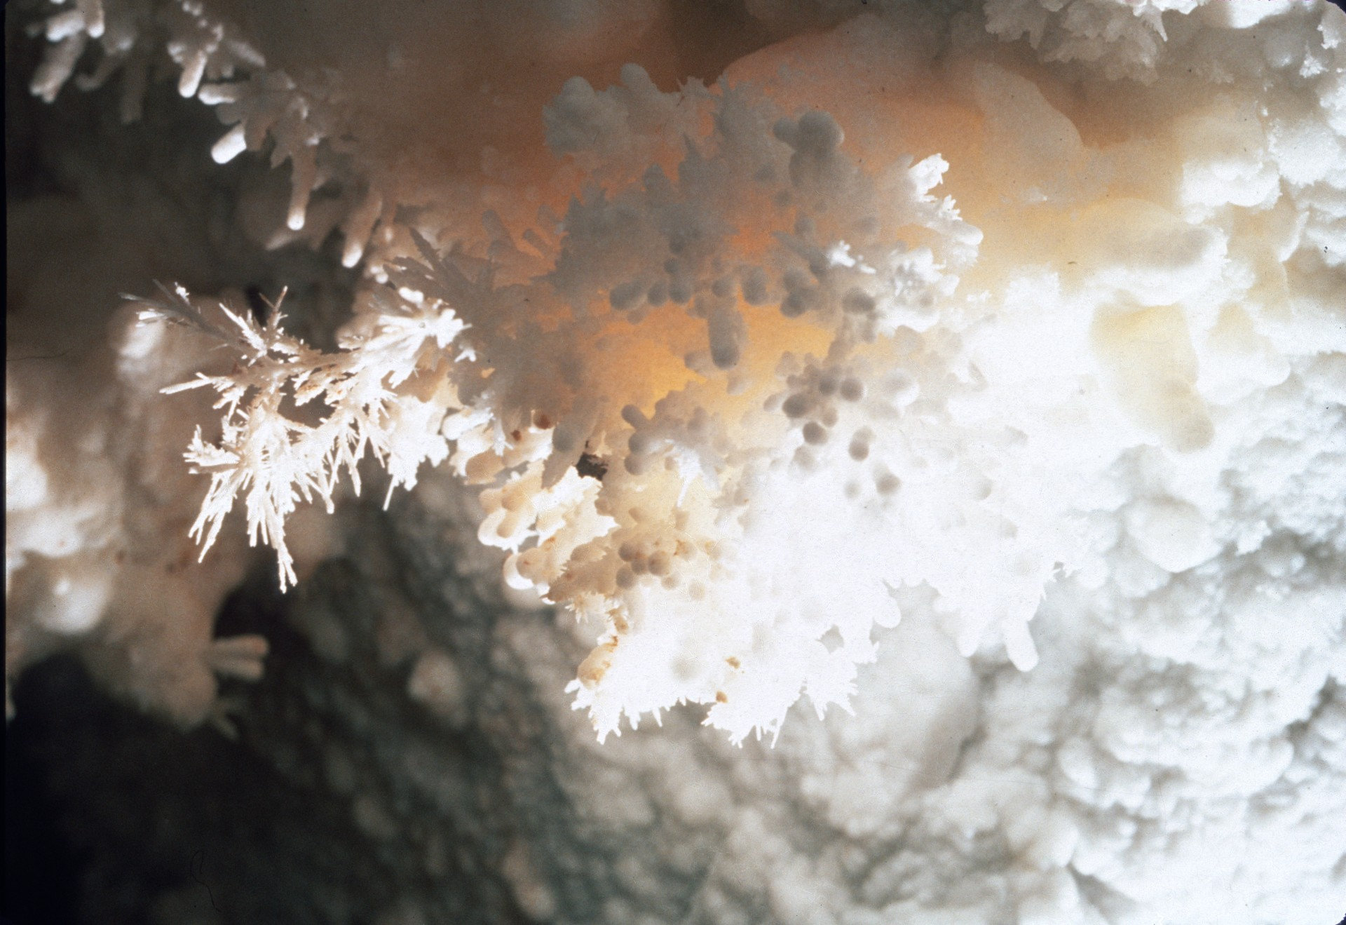

Slide 49
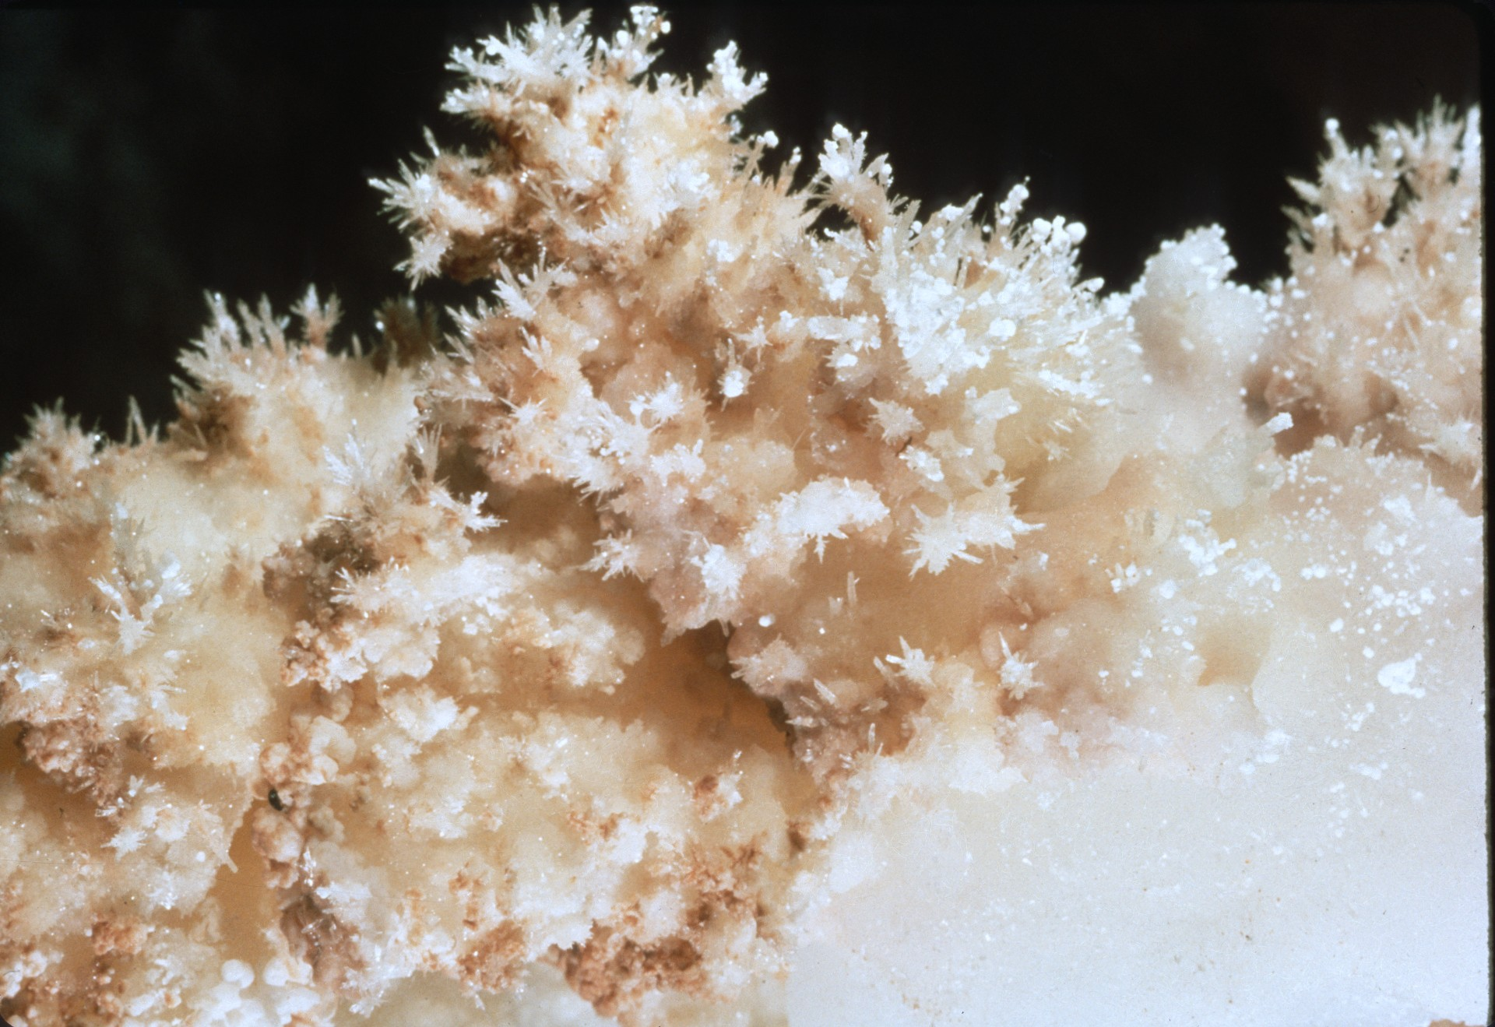

Slide 50
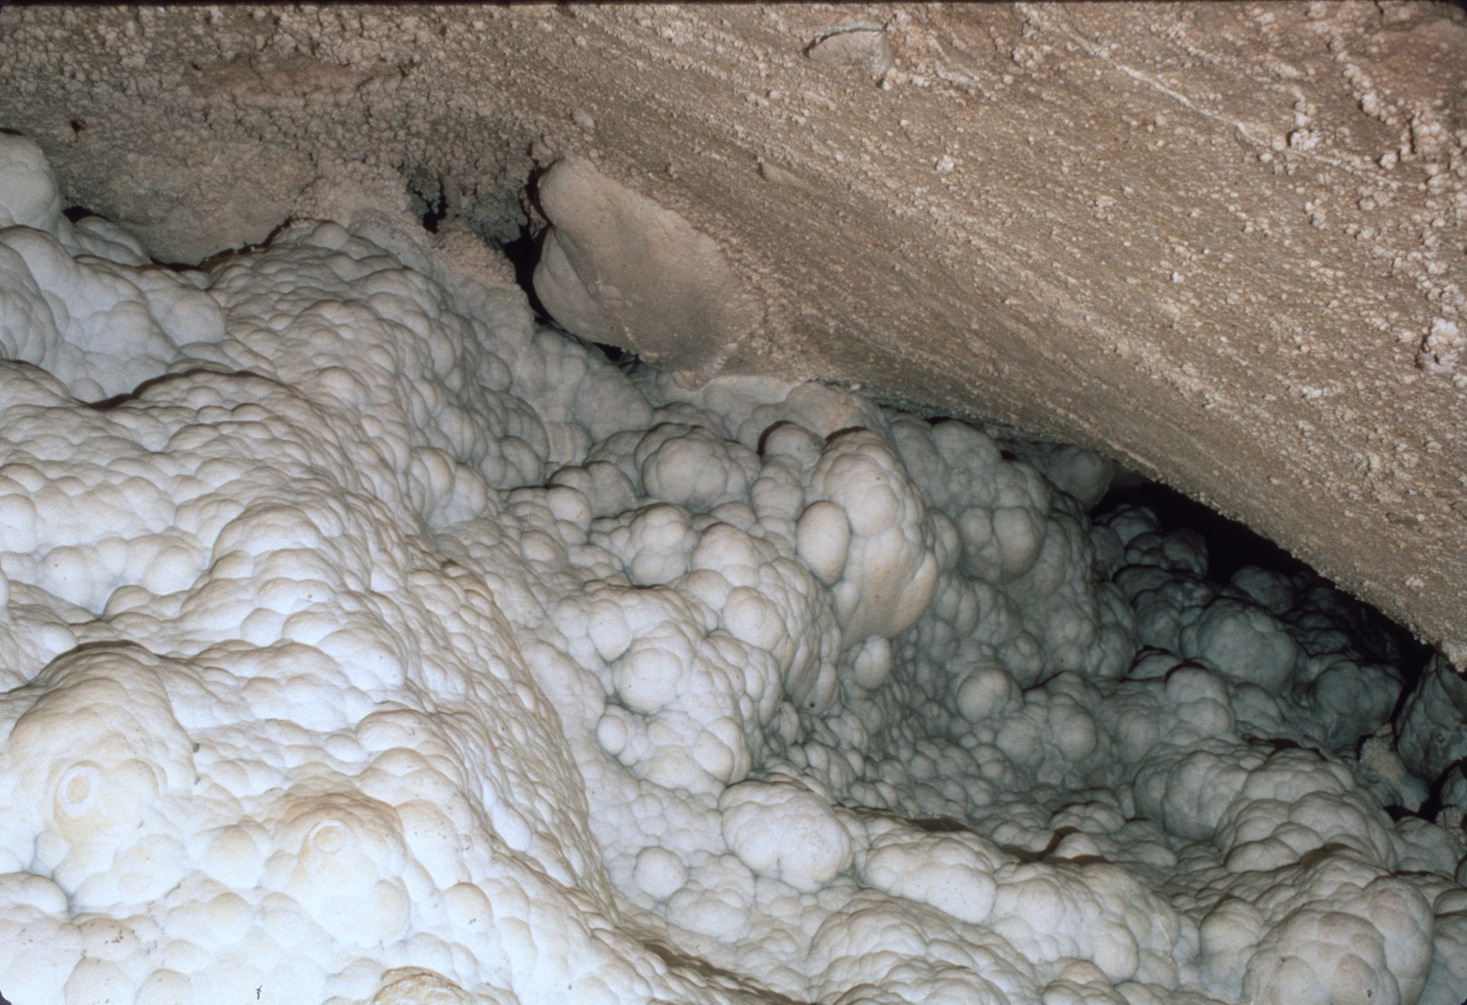
Notes:
As we descended closer to the Lake of the Clouds, you could see the “clouds” on the ceiling.

Slide 51
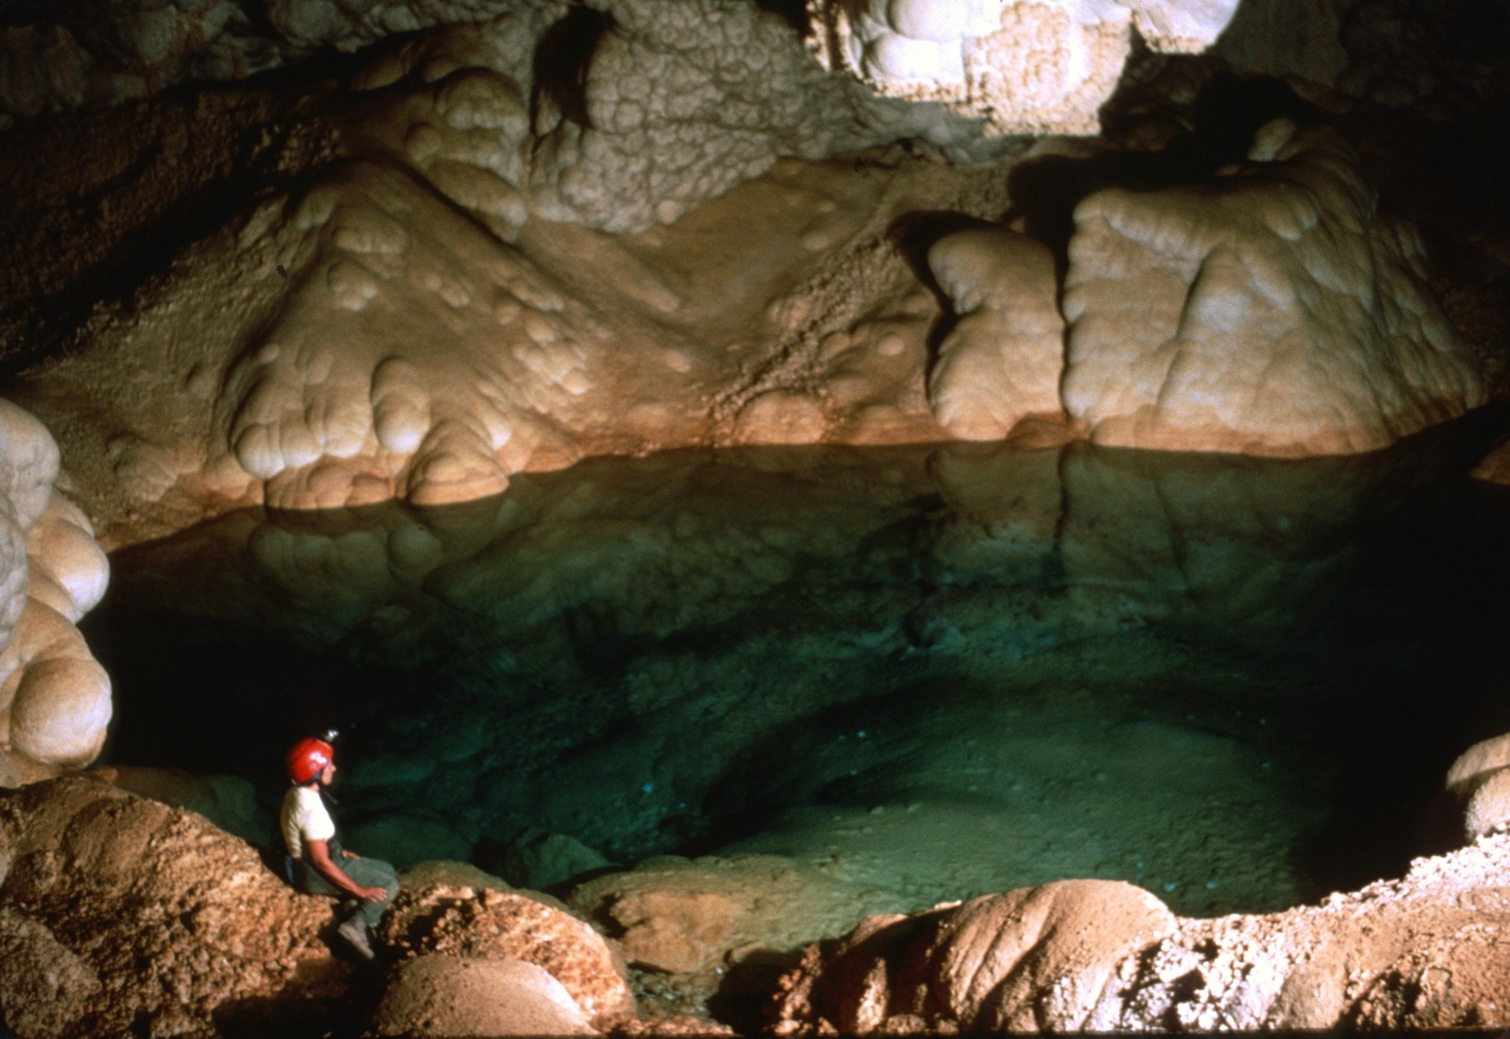
Notes:
Then 1,037 feet below the entrance was Lake of the Clouds.

Slide 53
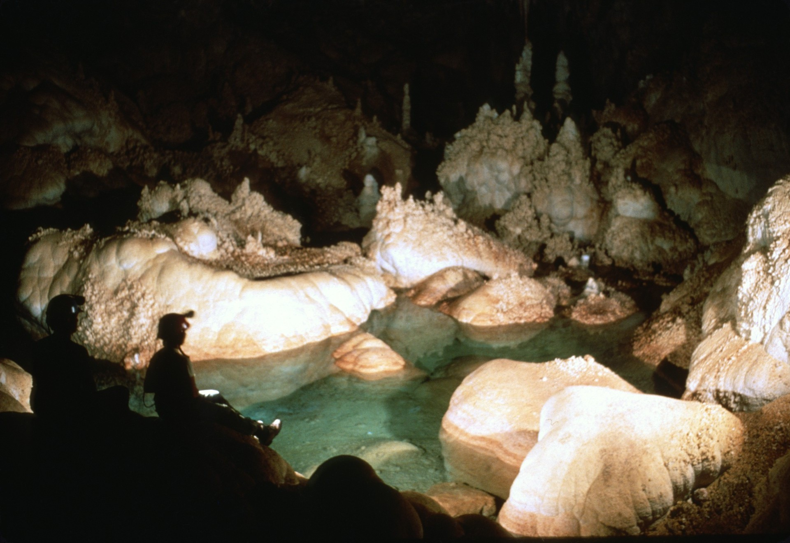

Slide 54
Spider Cave Carlsbad Caverns National Park
Notes:
At the end of the five-day restoration project, we were able to get a permit to enter Spider Cave, one of the wild caves in the park.

Slide 55
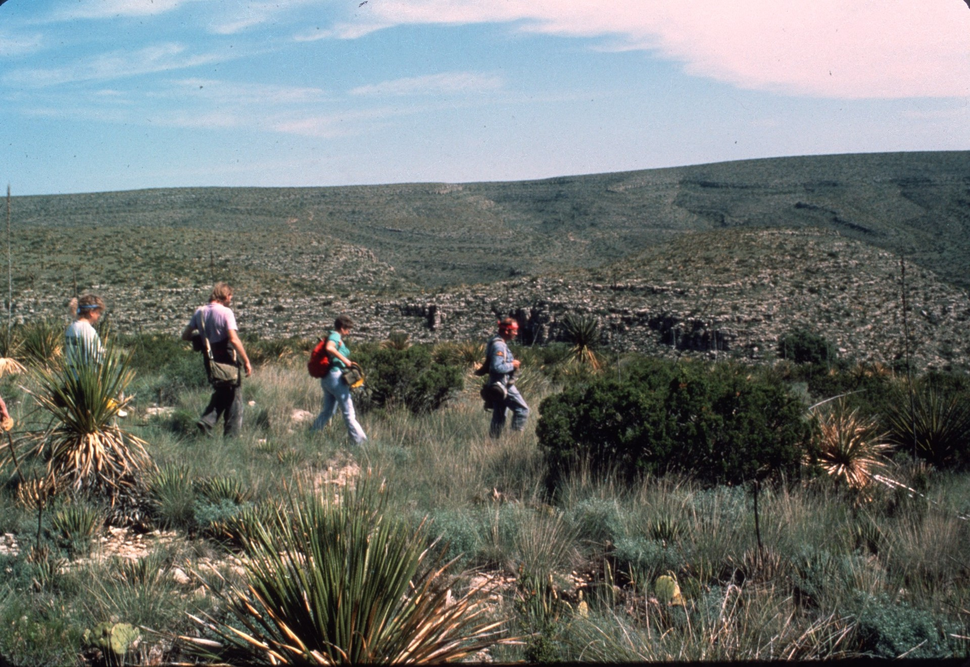
Notes:
Parking on top of the ridge, we descended into the canyon below.

Slide 56
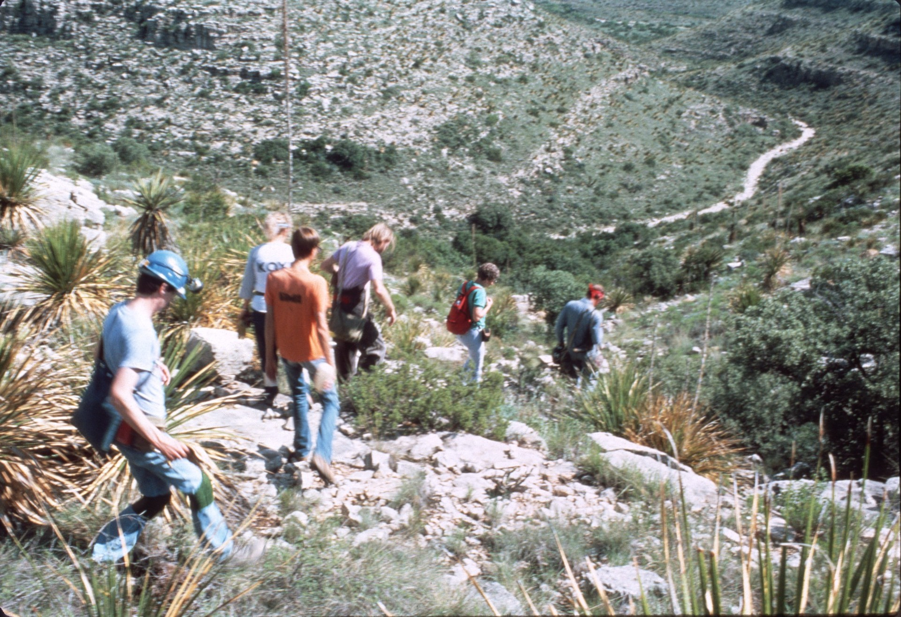

Slide 57
Notes:
A short walk along a dry streambed…

Slide 58
Notes:
…brought us to the gated entrance.

Slide 59
Notes:
After climbing down a small pit and negotiating a short belly crawl, the cave opened up with a blood red formation just ahead.

Slide 60
Notes:
Gradually the passage became lined with white formations.

Slide 68
Notes:
In one area the formations grew from a shelf in both directions.

Slide 70
Notes:
Along the way were fossils in the wall.

Slide 71
Notes:
Several white colored formations had a strange silver colored fan marking at their base.

Slide 72
Notes:
In one room the mud stain part way up the formations indicated past flooding.

Slide 75
Notes:
After several hours exploring Spider Cave, we reluctantly left.

Slide 76
Notes:
So ended the 1986 Carlsbad Caverns Restoration Project. Not only was the cave floor in the Big Room returned to its natural state in several very visible locations, but the many tourists who stopped to ask “Why?” now appreciate the value of caves. They were impressed that cavers from across the country felt this was so important that they spent their limited vacation time and paid their expenses to help out. Those who participated found the experience rewarding. We got to know Carlsbad Caverns well and left the cave better off for the experience.

Slide 77
An NSS Audio-Visual Library Presentation
Carlsbad Caverns Restoration Project
Original slide program S202
Cave map by Cave Research Foundation
Photography by Paul and Lee Stevens, 1986
Slides digitized by David Caudle
PowerPoint program created by Jim McConkey
77 slides, with script in presenter notes
PowerPoint created 1/21/2021
National Speleological Society
6001 Pulaski Pike
Huntsville, AL 35810-1122
256- 852-1300
nss@caves.org
https://caves.org/
Notes:
Credits: The cave map was by Cave Research Foundation. The slides were by Paul and Lee Stevens.

